Slide 1


Tempo Timesheets
JIRA plugin
Sapphire • Linksoft Inc • @ Live DEMO 2015
V0.1

Slide 2
Developer Up
Development powered by Atlassian
Leon Hou • Linksoft Inc • @ Live DEMO 2016

Slide 3
Why are we here?
Notes:
Objective - better understand the needs of the development team these sys admins are supporting.
Understand the impact developers have to the tool selection process.

Slide 4
The plan
Set the stage
Software talk
developer example
putting it together
q & A

Slide 5
Set the stage

Slide 6
Every company is a software company

Slide 7




























Our customers are innovating in every industry
HEALTHCARE
FINANCE
MEDIA
AUTOMOTIVE
CONSUMER
TECHNOLOGY
HEALTHCARE
Notes:
Software creation happens in every industry
In order to build this software you need skilled engineers
For example, the Finance industry doesn’t traditionally call themselves software companies. They do math, but these days, math is done with software and computers. Thus, they need developers.

Slide 8
11,005,000
Notes:
Number of estimated professional software developers globally in 2014 - IDC (international data corp.), a market analyst group. Doesn’t include hobbyists (7.5 million).
http://www.infoq.com/news/2014/01/IDC-software-developers
Number of software developers in the US alone is expected to grow 22% from 2012 - 2022 - US News
http://money.usnews.com/careers/best-jobs/software-developer
That’s a lot of possible Atlassian end users - the Business listens when this group speaks

Slide 9
Software talk

Slide 10





PLAN
Prioritize & Assign
DEFINE
Document & Discuss
Software development workflow
DEVELOP
Code, Test, Review
OPERATE
Deploy, Learn & Iterate
Notes:
Atlassian has a simple philosophy on software development. Whether it be Agile or Waterfall, the process boils down to these 4 phases.
Define: decide what it is you want to build (Confluence)
Plan: prioritize and assign work (JIRA)
Develop: actually build the product, test it, and review the changes (Dev Tools & JIRA)
Operate: deploy the product, learn, and iterate (Dev Tools, JIRA, JIRA Service Desk)

Slide 11
PLAN
Prioritize & Assign
DEFINE
Document & Discuss
Software development workflow
DEVELOP
Code, Test, Review
OPERATE
Deploy, Learn & Iterate
Notes:
Today we’re going to focus on the Develop phase, which commonly includes JIRA, Bitbucket, & Bamboo.
Let’s get started. What do you picture in your mind when you think of software development / coding / programming?

Slide 12

Notes:
Do you picture stuff like this?
Well that’s not really what it looks like. Depending the the coding language it can take on many forms, but for the most part, it looks like this -> Click.

Slide 13
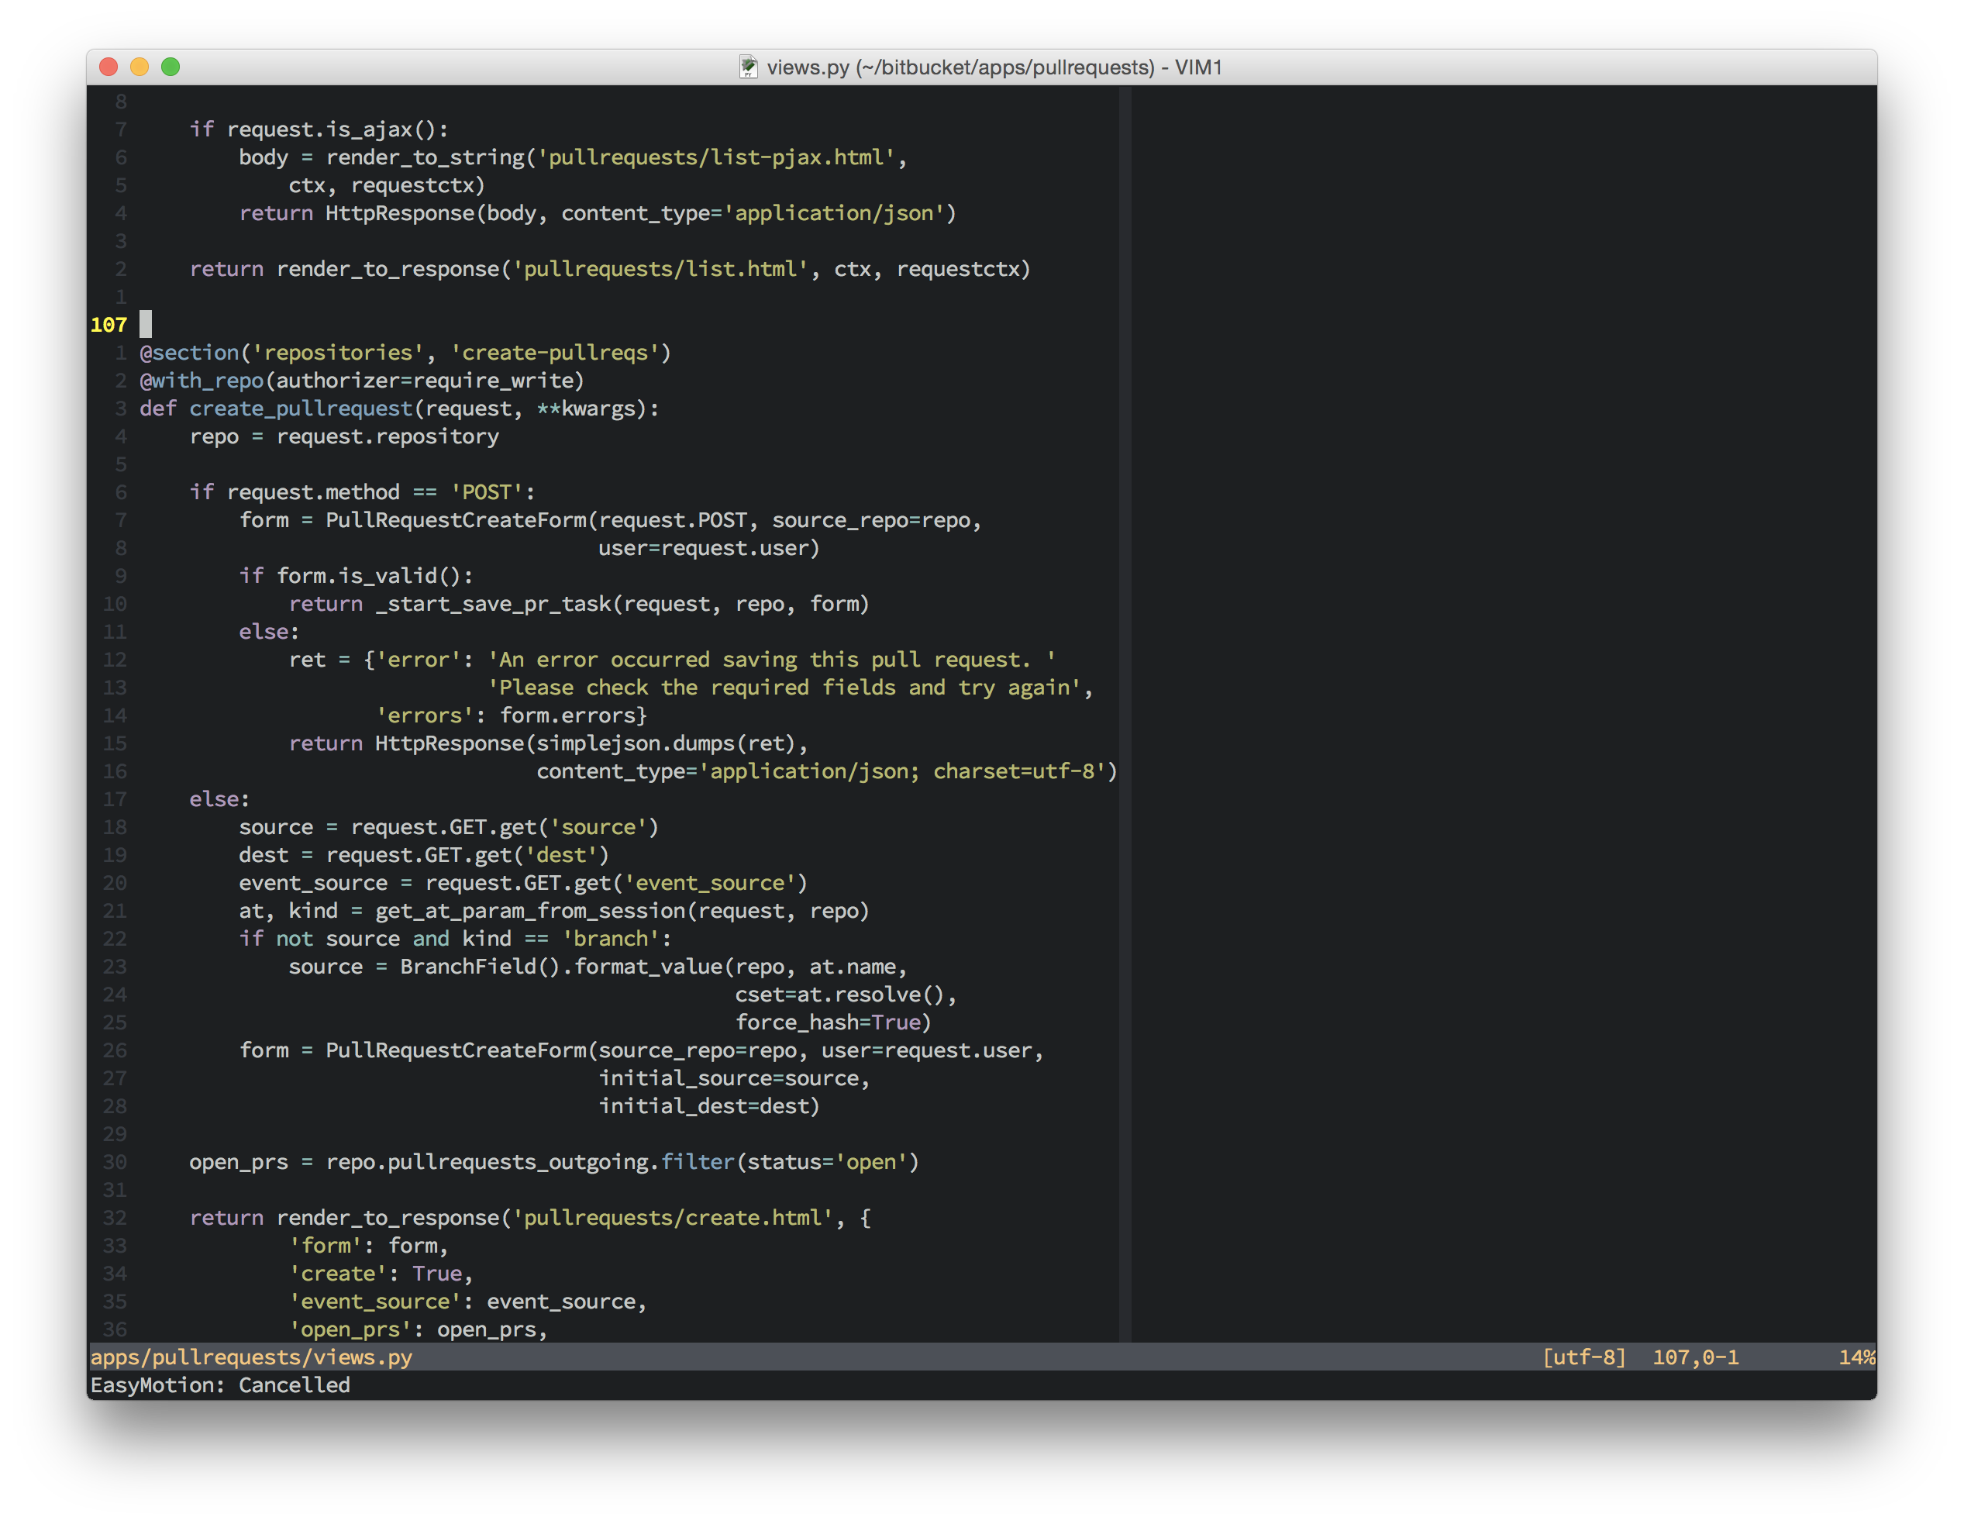
Notes:
This is real Bitbucket Python code.
Code is logic. We have to write logic that can be made readable by computers to tell them what to do and when to do it. For example, “if i click a button, this window will display and show me this picture”

Slide 14
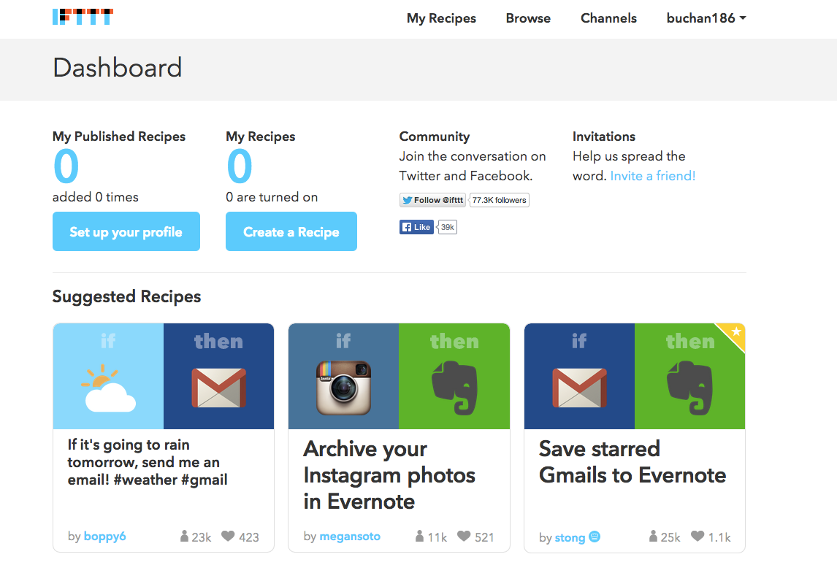
Notes:
A basic logic example is the website “If this then that”. For example, you can set it up to email you to wear shorts if it’s sunny outside.
If the weather is sunny, email me “wear shorts”.

Slide 15
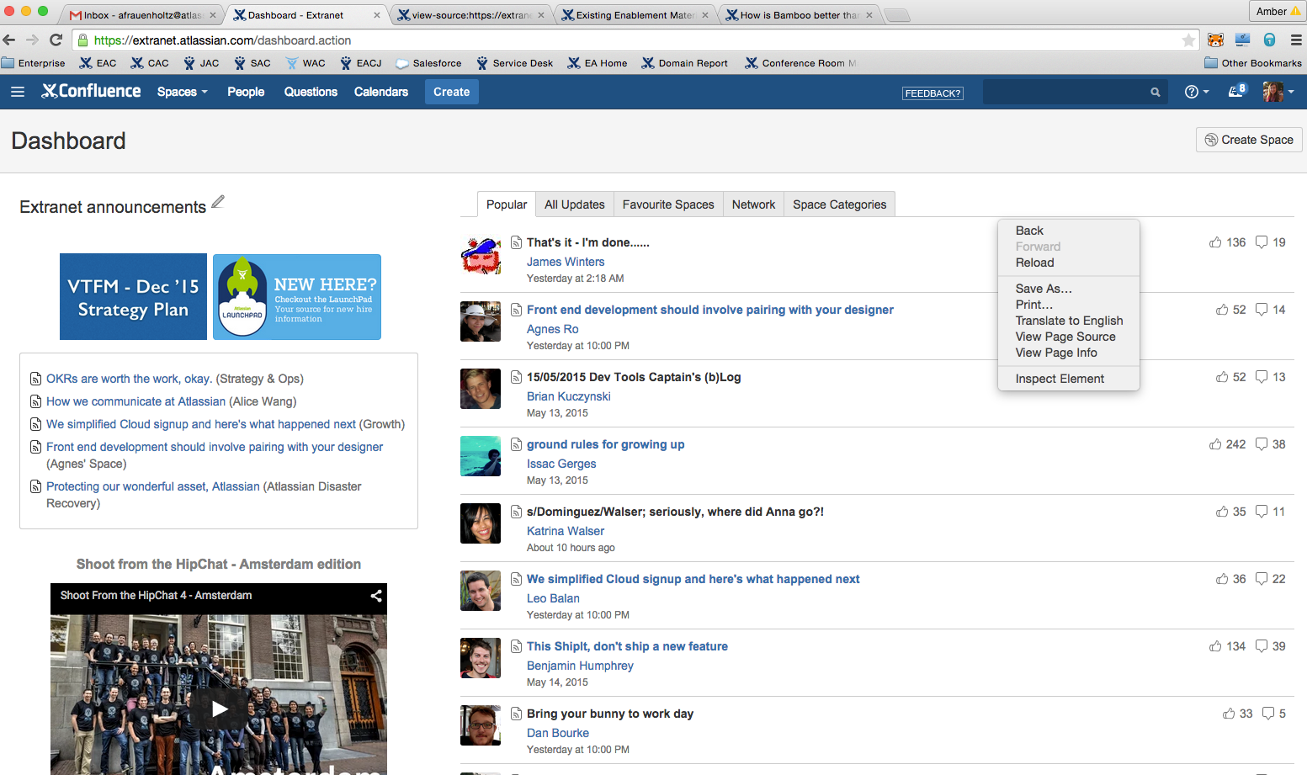

Notes:
One more example. Have any of you ever right-clicked on a webpage and hit the “view source” button?
The code and logic is there for you to see - it’s in every piece of software there is.

Slide 16
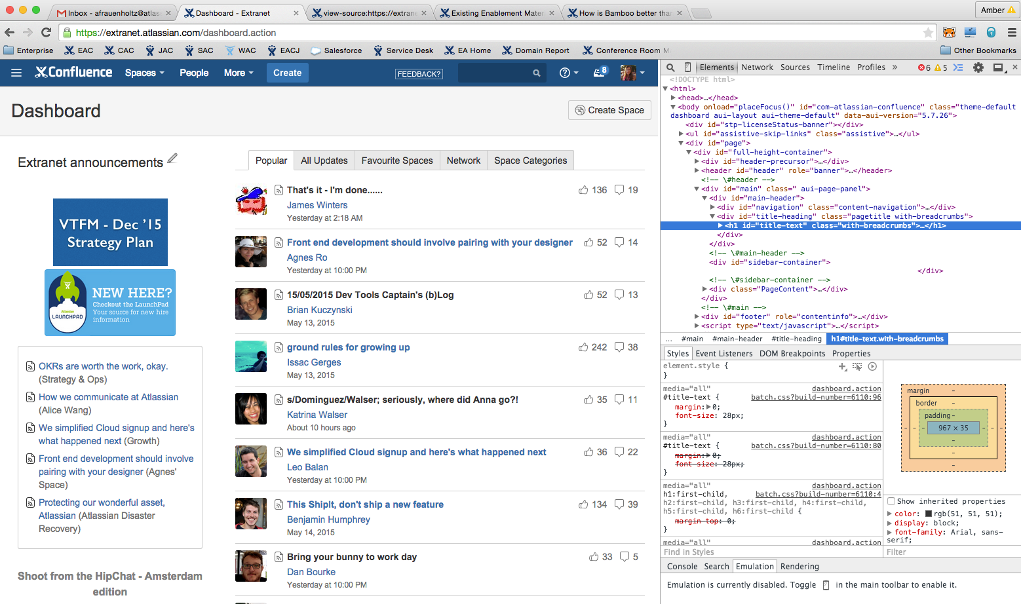

Slide 17






















????
Notes:
Writing code, ensuring it’s of high quality, and releasing it for end users can involve any number of tools.
Tools can change based on coding language, developer preference, or mandated organizational toolsets. Developers have to navigate this ecosystem, select the best tools for the job, and determine how they work together, if at all. Not to mention there’s probably an organizational mandate for both traceability and visibility into the work that’s happening in this stage of the lifecycle.
The tools on the left are IDEs, or Integrated Development Environments. These are like the “Microsoft Words” of writing code.
The tools in the middle are version control / repository tools. These act like storage lockers for your code base and allow many developers to work on the same code base at one time.
The tools on the right are everything else. There are all kinds of things available to developers, analytical tools, build tools, automation tools, etc….

Slide 18





Notes:
We want to make this easy for everyone by giving you a clear set of tools to get code written. All the while passing feedback back up to other stakeholders (i.e. PMs, Managers, etc…).
Atlassian gives you a clear path, helps to make sure code is high quality, and provides traceability throughout the entire simple philosophy of software.

Slide 19

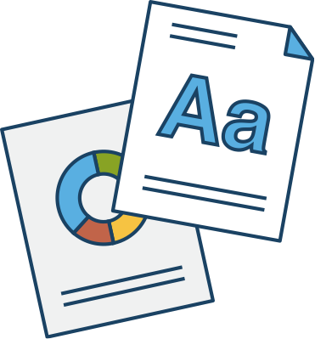




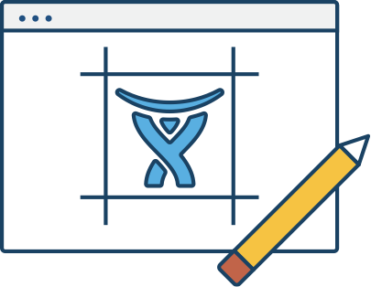


if this == that
  return;
else
  this = 1;
Notes:
Our developer has selected his tools, now let’s talk about what a development process can look like. Note, this will vary wildly depending on all the variables we’ve discussed today. This is a high level example.
Requirements are passed to development
Development begins to code
Developer tests and collaborates with the team, i.e. code review, integrate
Code/feature is released
Feedback is sent to the business at every stage, i.e. pass/fail, progress, etc..

Slide 20
Work Assignment
Test / Review
if this == that
  return;
else
  this = 1;
Write Code
Integrate
Release
Deploy
Notes:
Let’s put each step into a bucket:
Work Assignment
Write Code
Test, Integrate, Deploy (i.e. code reviews, running test cases, and deploying code to staging, etc..)
Release

Slide 21





Notes:
Mapped to different Atlassian tools, the workflow looks like this. Remember HipChat is involved for constant communication between all of these steps.
Note… this is an IDEAL end state. Most development teams and leaders you talk to, won’t be here yet. There will be big holes in their process, i.e. they’ve never heard of a pull request.
Although that seems bleak, this is where they want to go. We’re not only selling them kick-ass tools, but also a framework for developing kick-ass high quality code.

Slide 22
Real-life Example
Notes:
Let’s look at a real-life example. We’ll follow one of our Bitbucket Cloud developers through the stages of developing a new feature for Bitbucket.

Slide 23
Work Assignment

Slide 24
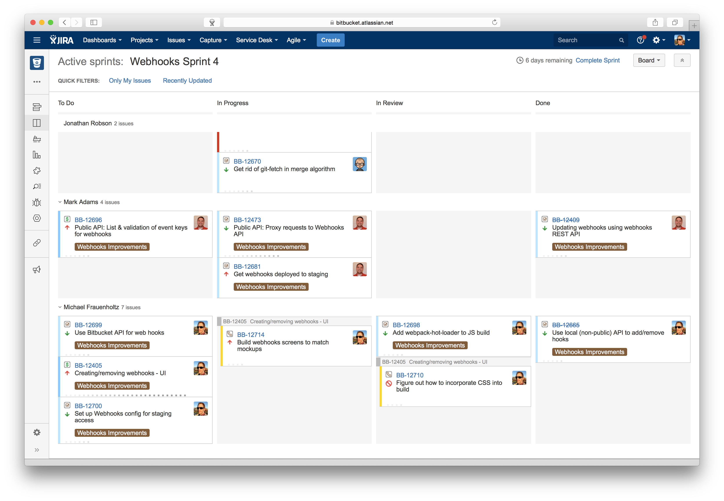

Notes:
This is the ATX Bitbucket’s team active sprint board in JIRA Agile. Right now they’re working on the web hooks project. This will make it easier for teams to integrate directly into Bitbucket Cloud, i.e. when an action happens in Bitbucket, do something in another system outside of Bitbucket.
Mike, the developer, moves one of his issues from To Do to In Progress.

Slide 25
Write Code

Slide 26
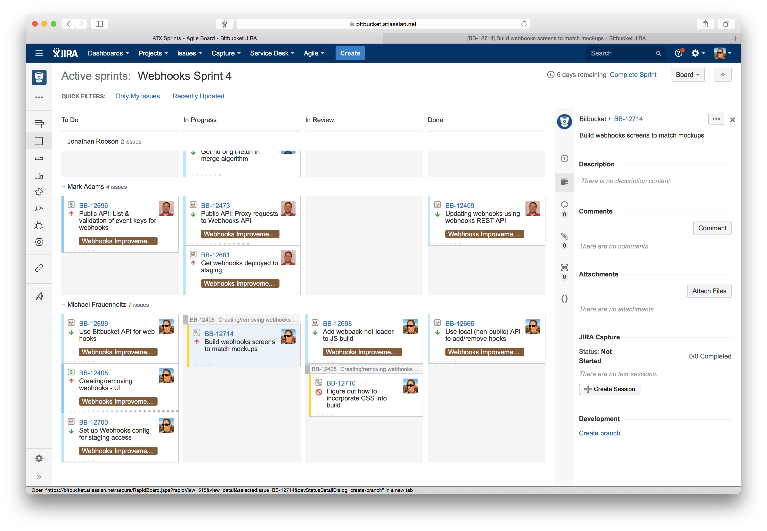

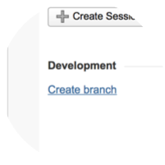
Notes:
Mike clicks on the issue and selects the ‘create branch’ button to begin doing his development. In this case, he’s going to build the web hooks admin screen to match the mockups handed over by the design team.

Slide 27
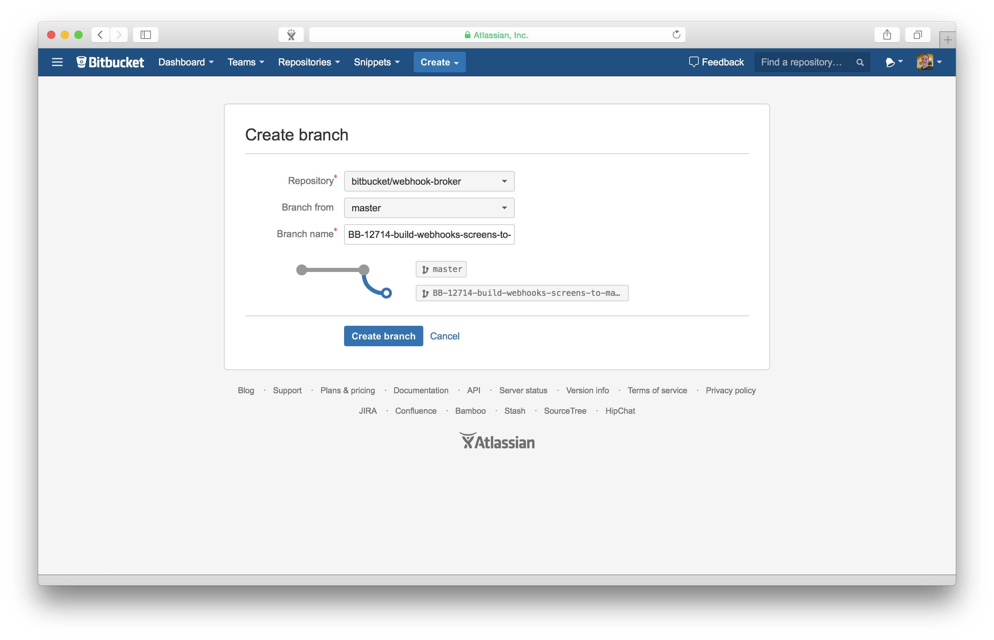
Notes:
He creates his branch using the integration between Bitbucket and JIRA.

Slide 28
Notes:
Mike uses VIM as his IDE, sort of like writing in a text editor, but with cool plugins

Slide 29
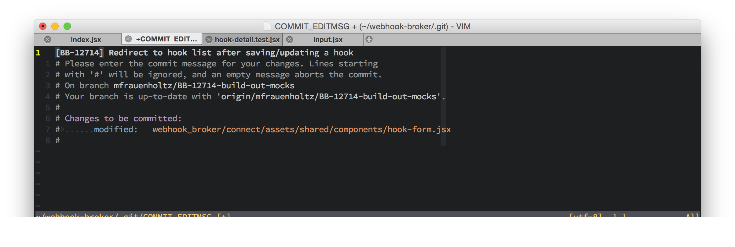
Notes:
Time to commit his code. Notice the JIRA issue key in the commit message.
He could also use SourceTree if he preferred a GUI.
Several more commits and changes later…

Slide 30
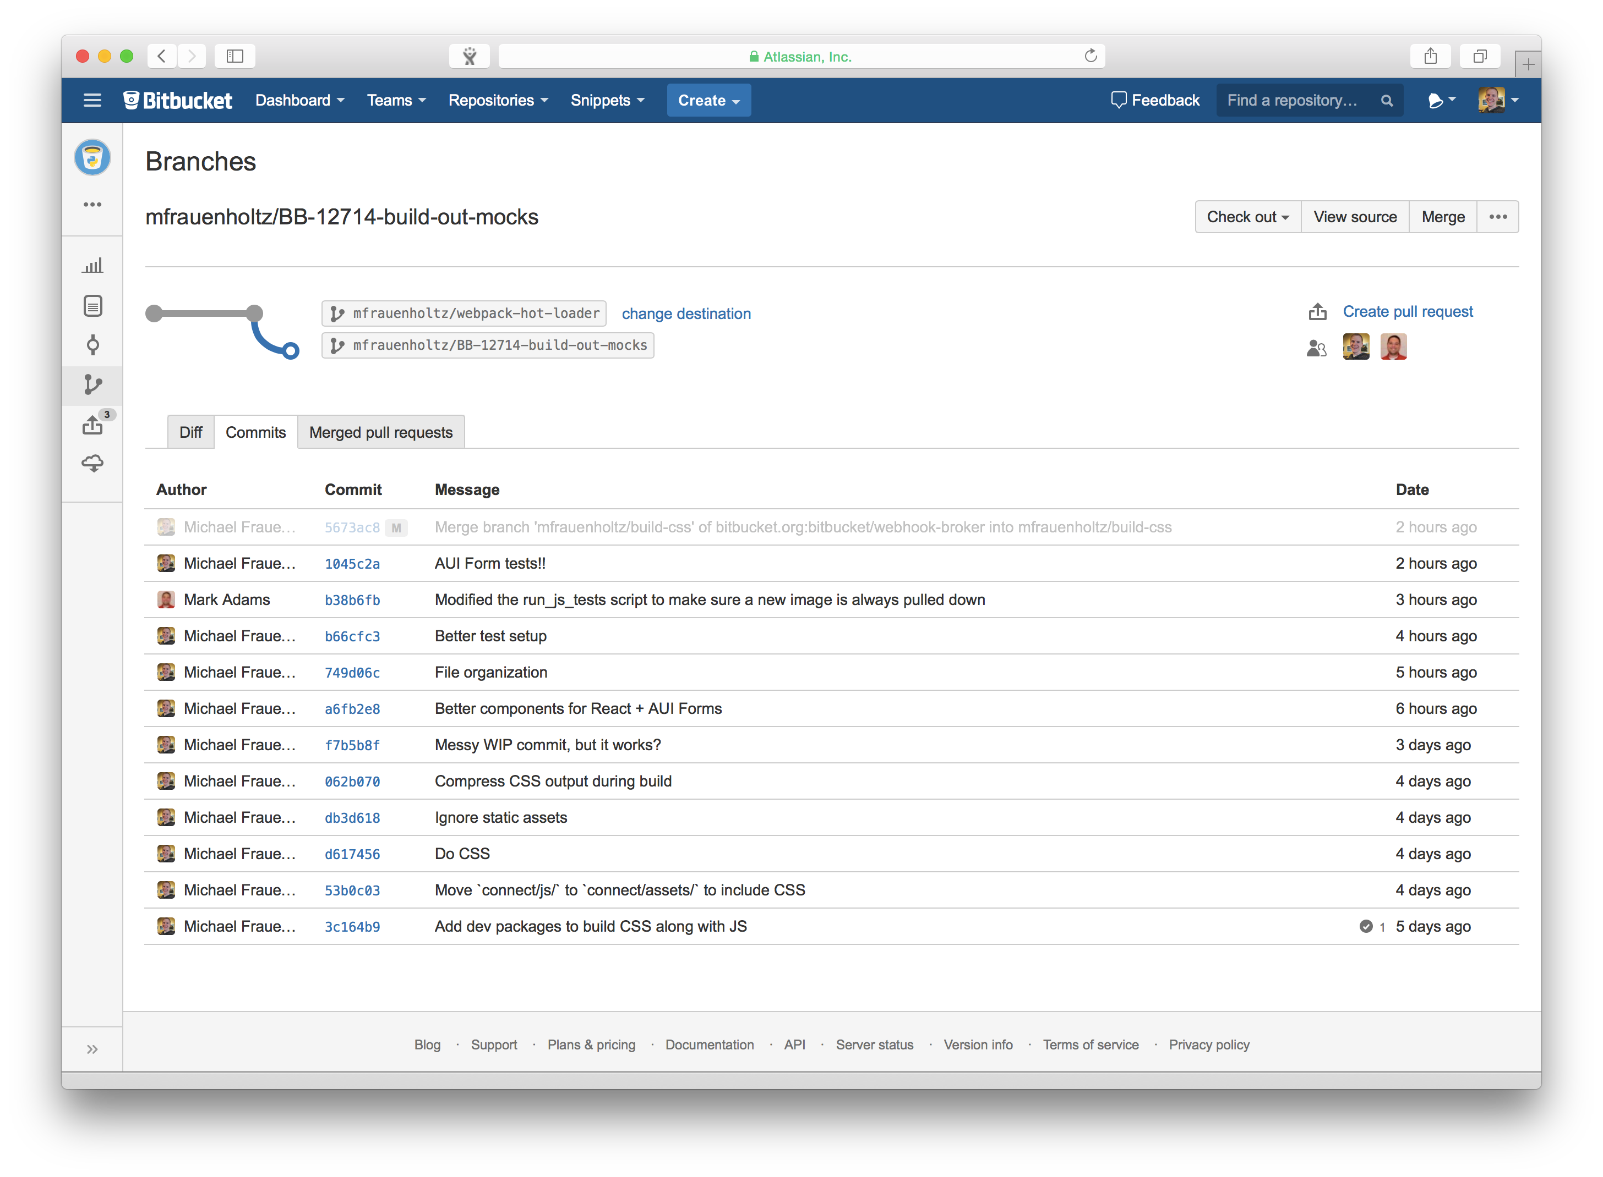
Notes:
He’s done. All of the commits are now shown in Bitbucket.

Slide 31
Test / Review
Integrate
Deploy

Slide 32
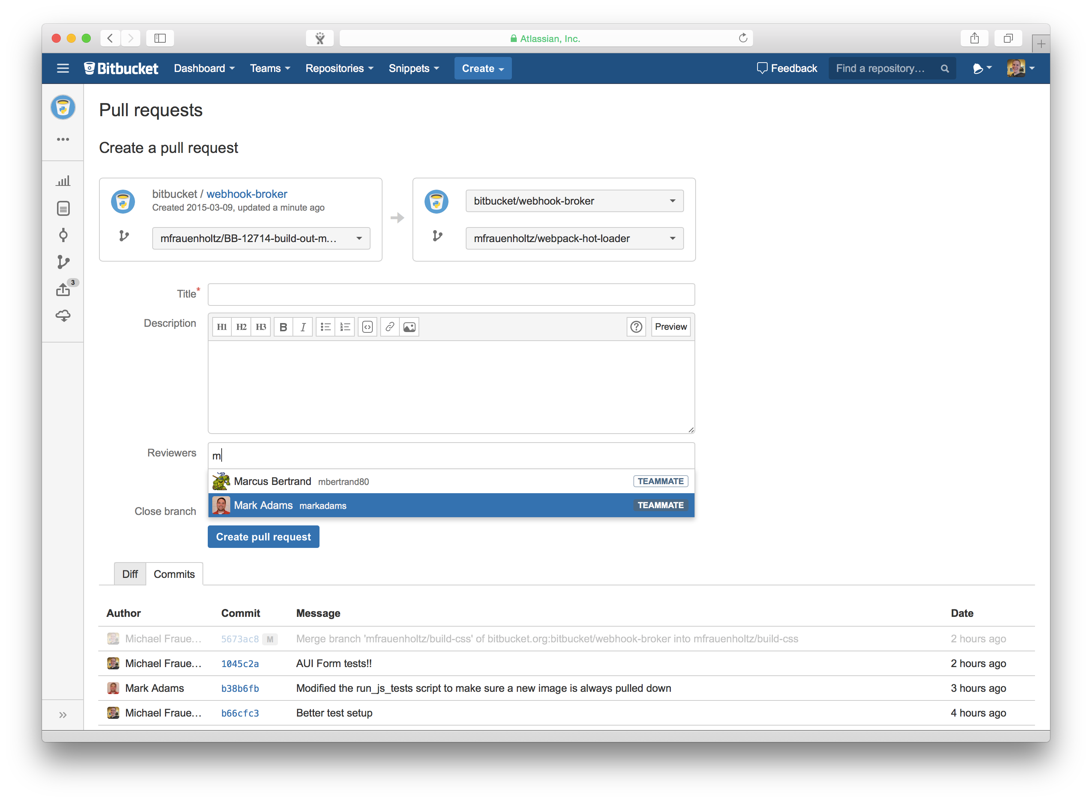
Notes:
Mike creates a pull request and adds reviewers to approve his changes.

Slide 33
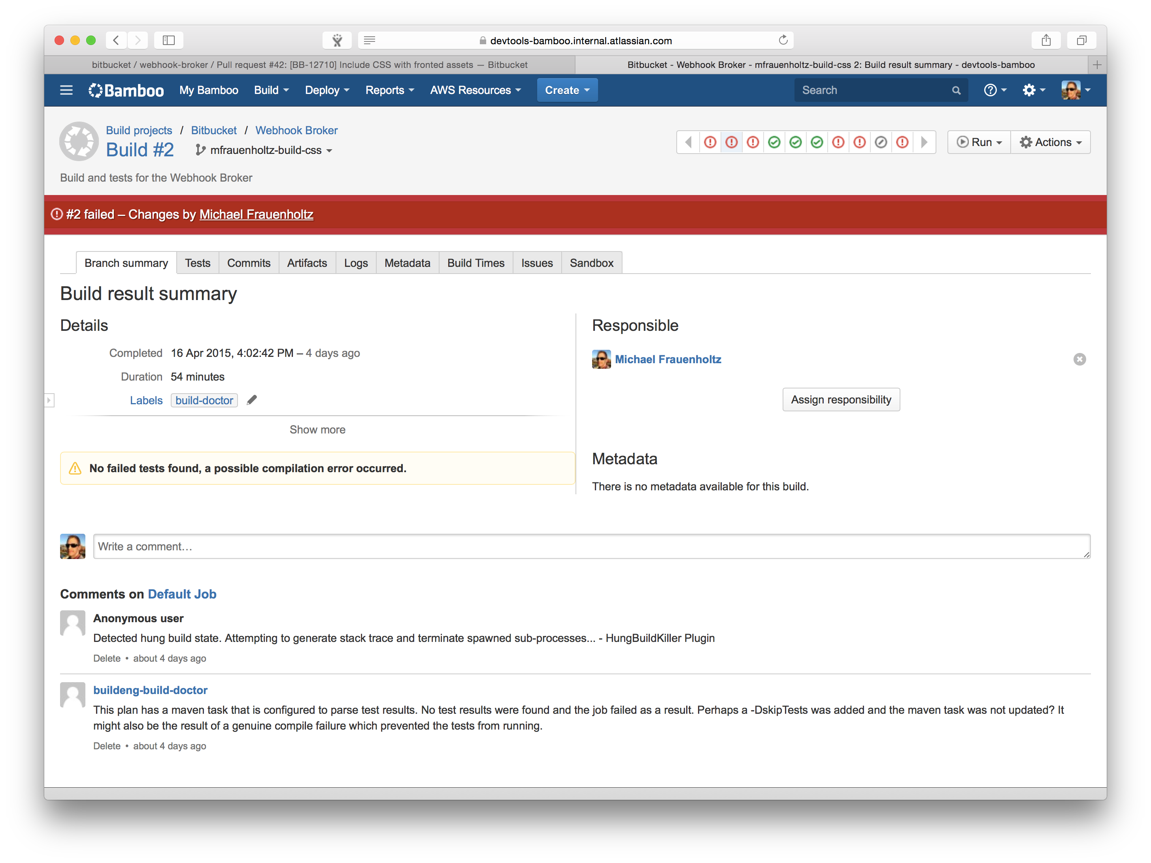
Notes:
In the background, Bamboo noticed he created a branch, and started running CI builds against his changes. There were some issues in the build so it failed.

Slide 34
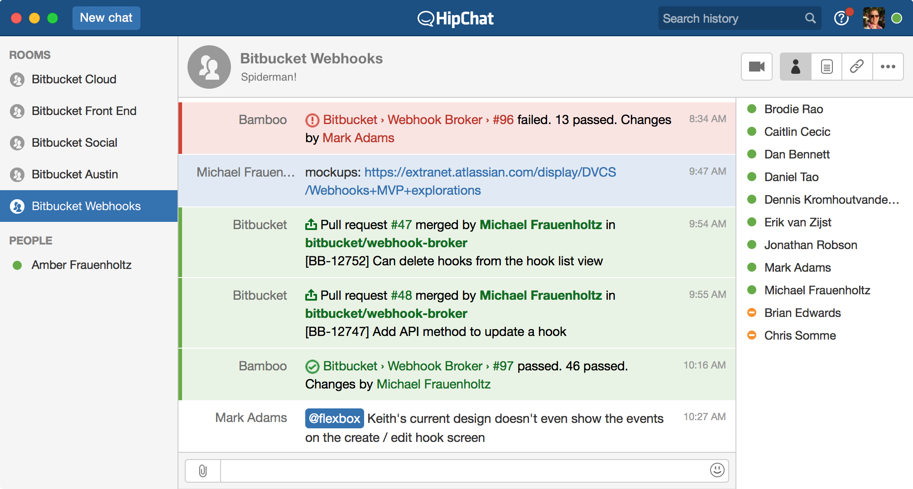
Notes:
Mike realized this when Bamboo pinged his HipChat room with the build result.

Slide 35
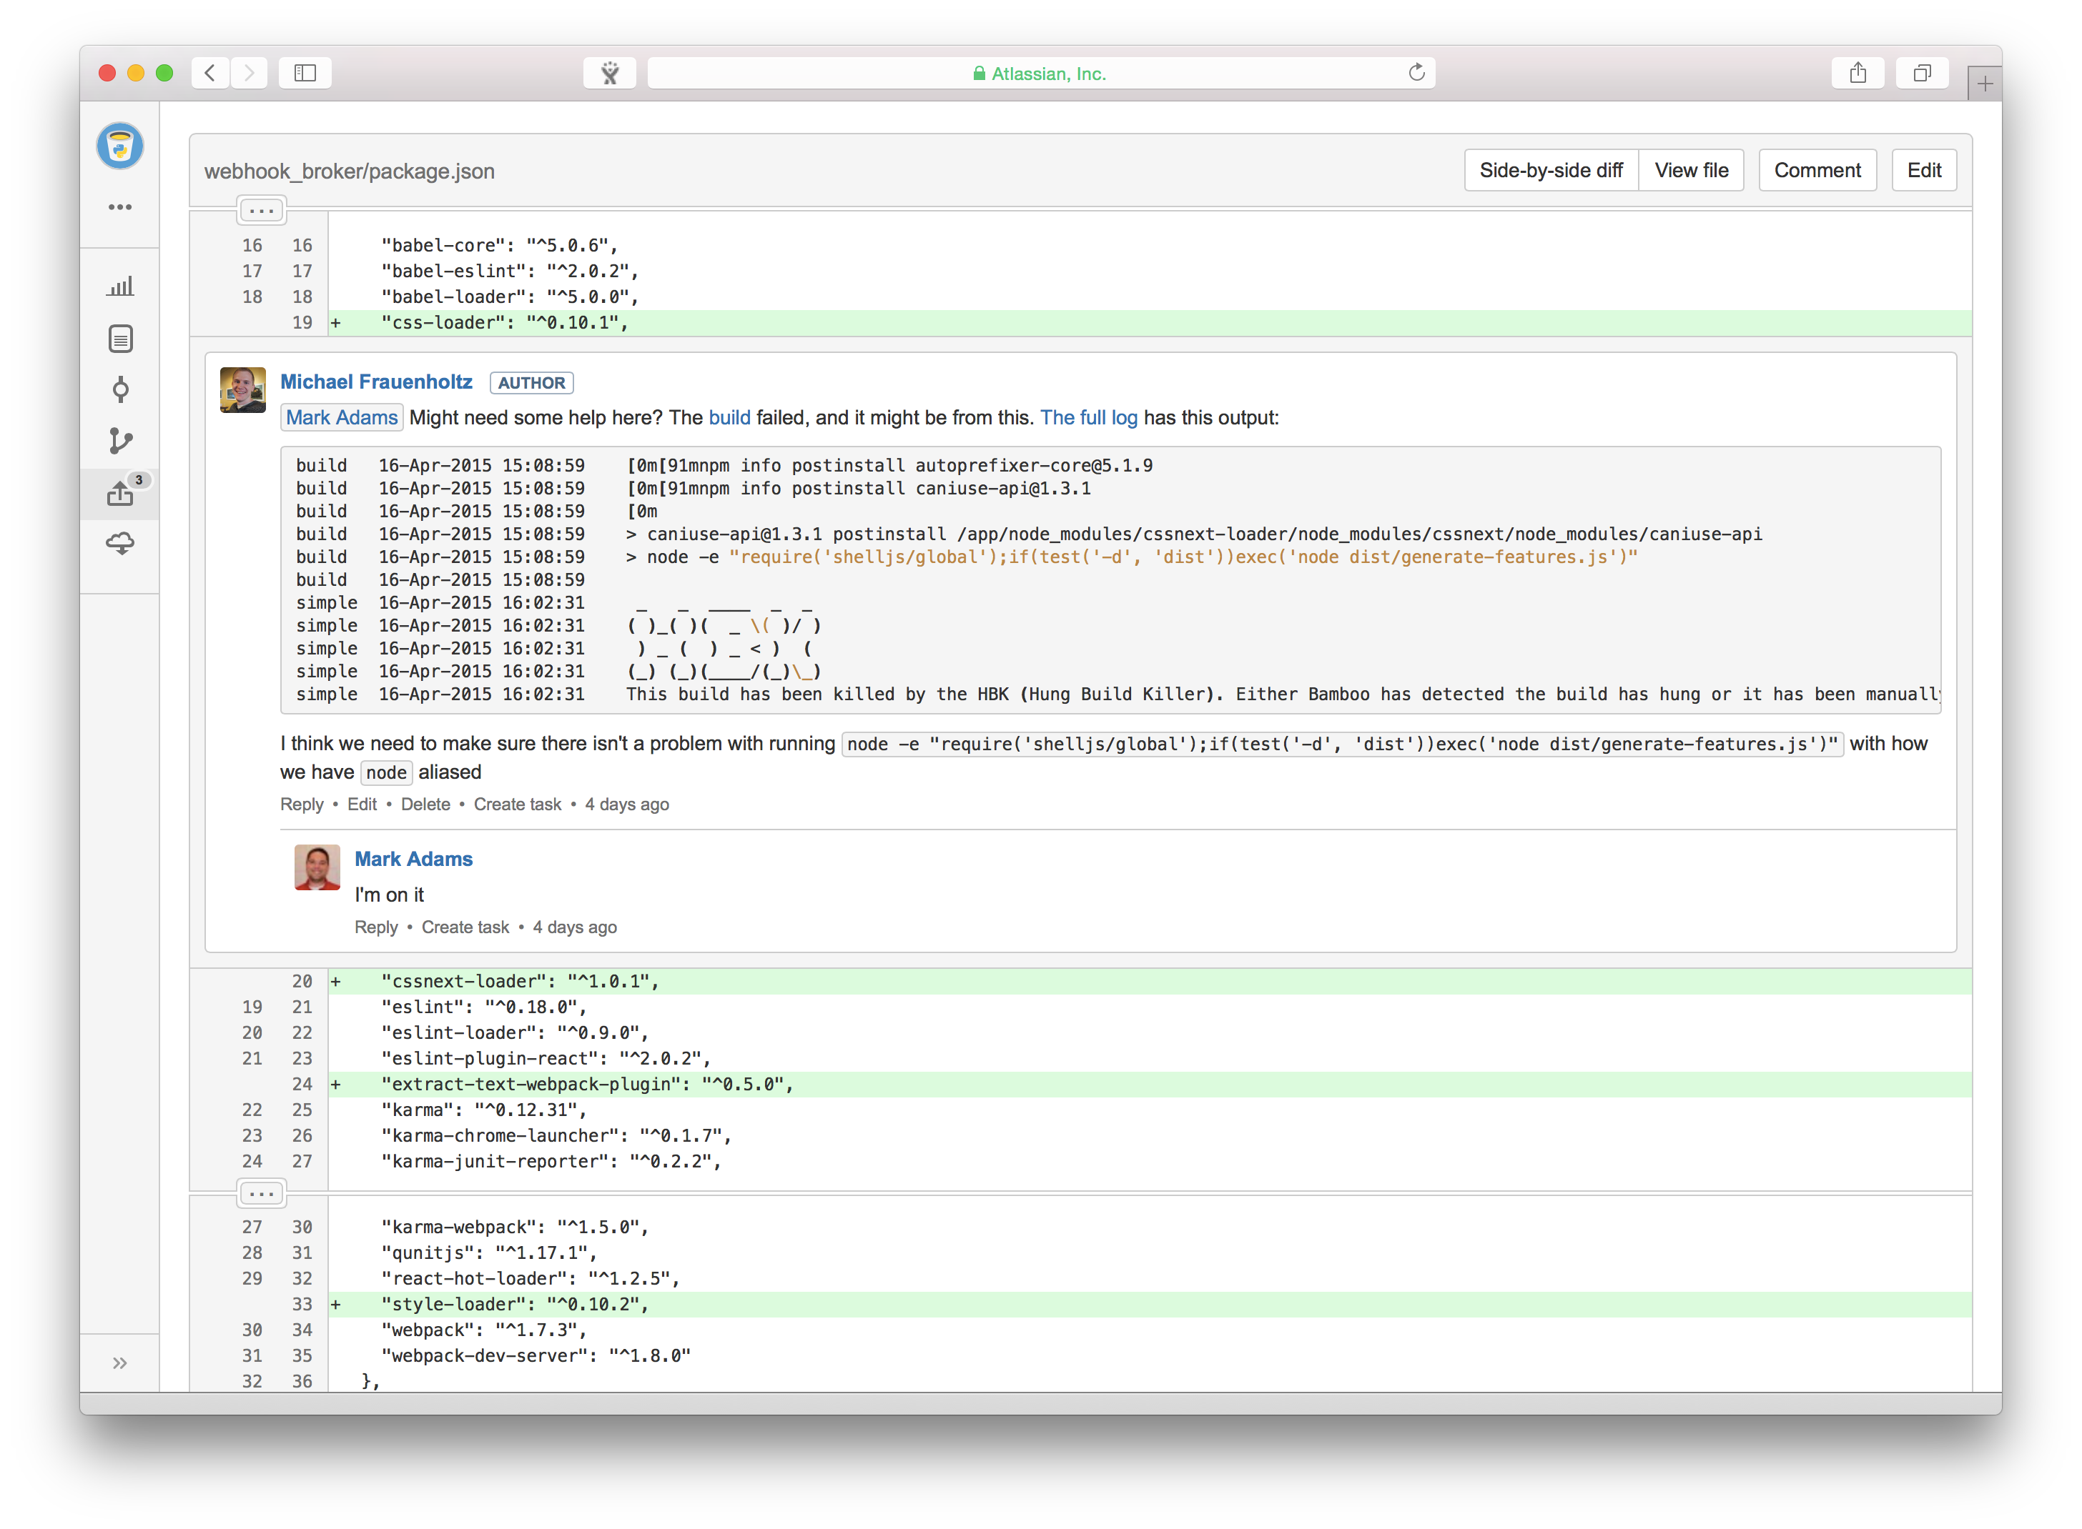
Notes:
He decides to ask for some help to fix the broken build in the comments of his pull request (code review).
His team member checks in and goes to look at the broken build.

Slide 36
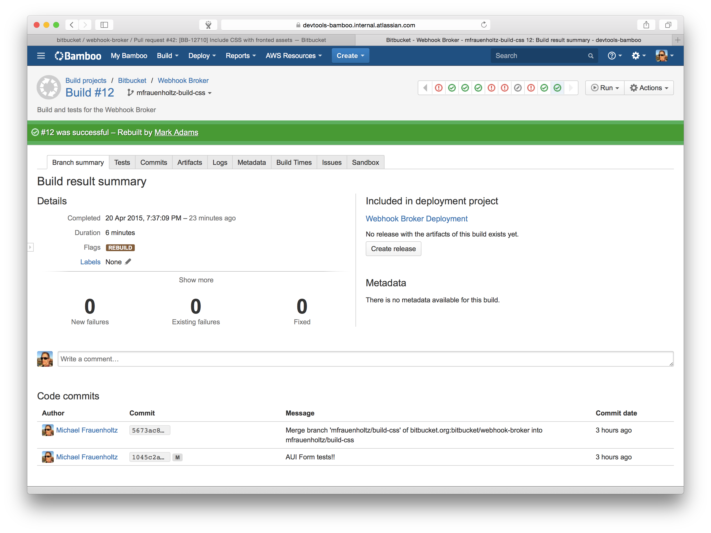
Notes:
The build is now green and ready to be approved.

Slide 37
Release

Slide 38
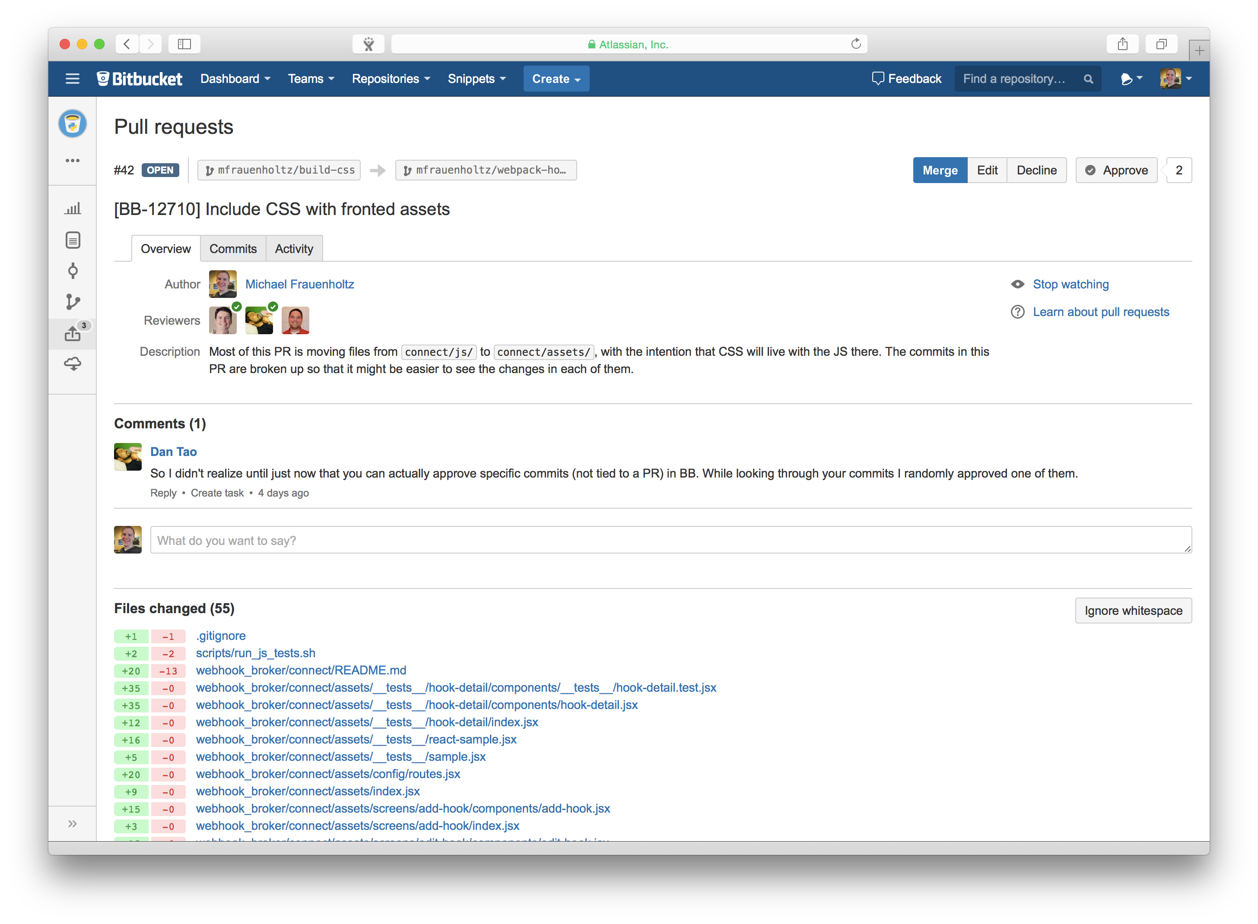


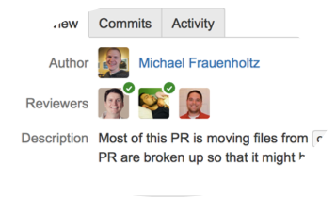
Notes:
The team approves the change, and merges the code into staging. It’s now ready for the next production deploy.

Slide 39
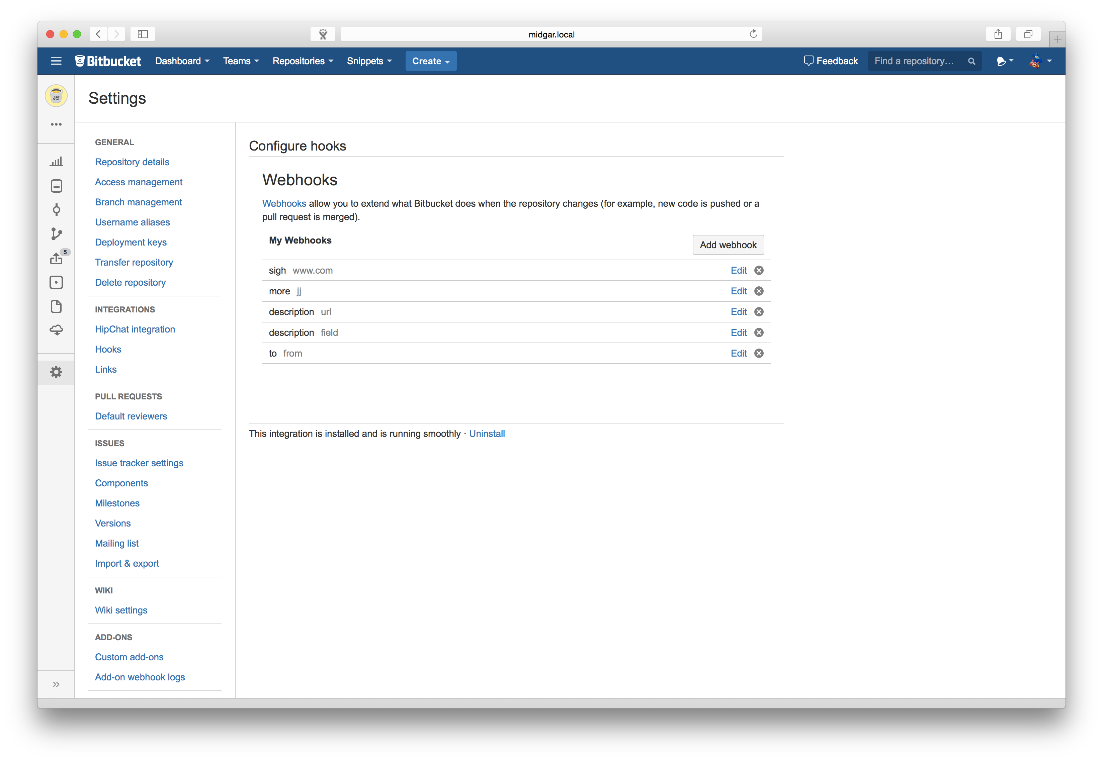
Notes:
The team can now view the feature live in their staging environment.

Slide 40
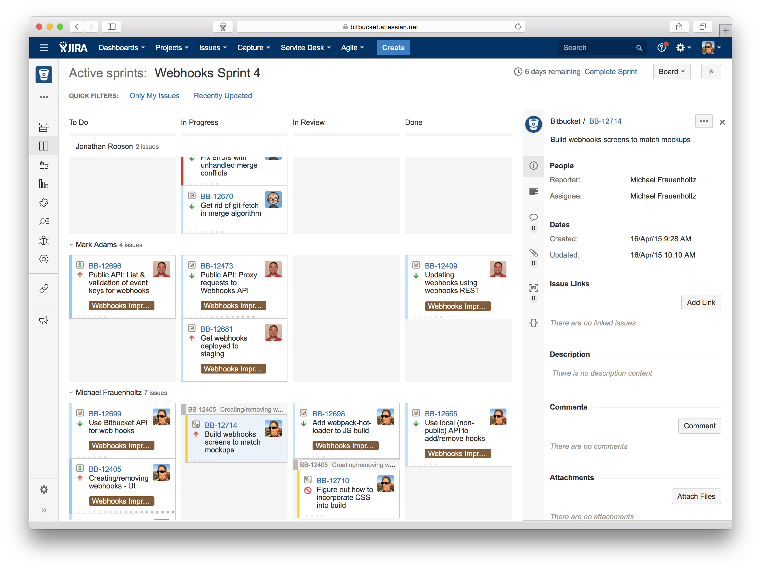
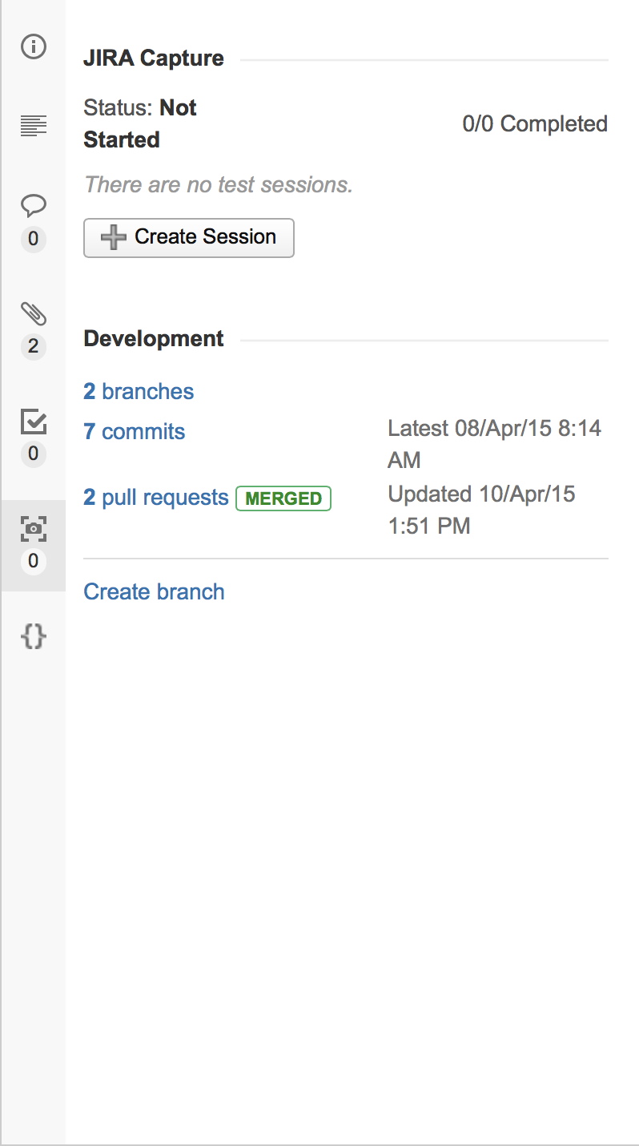

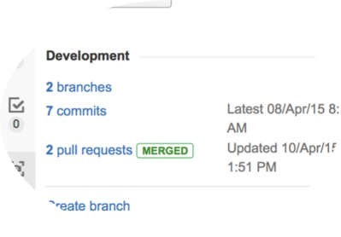
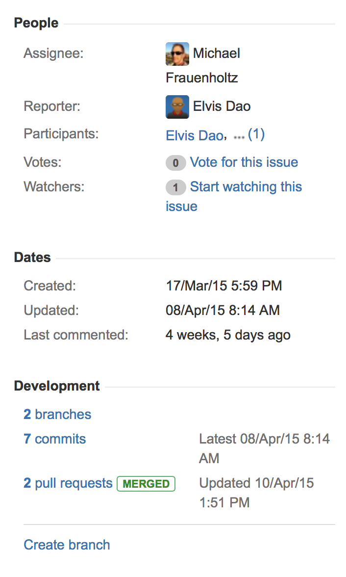
Notes:
Back in JIRA, you can view the linked commits, etc…

Slide 41
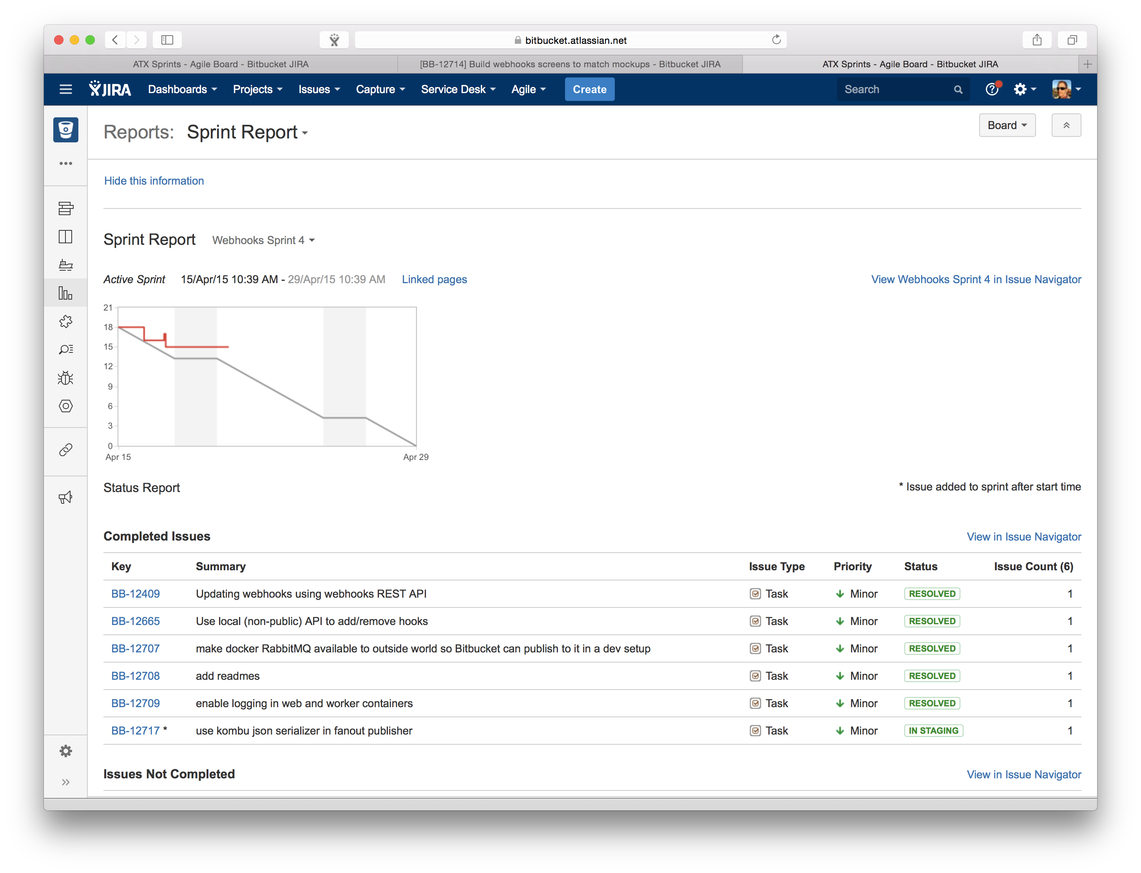
Notes:
The Team Lead can also look at the state of the sprint in JIRA’s reporting.

Slide 42
Putting it together

Slide 43
Work Assignment
Test / Review
Write Code
Integrate
Release
Deploy
Notes:
To review, a feature was assigned in JIRA. The developer began building the feature via Bitbucket. Bamboo built and tested the changes, and a code review (pull request) was done in Bitbucket. The feature was deployed to staging via Bamboo. Full traceability was kept in JIRA.

Slide 44
Notes:
By now I hope you have a better understanding of how developers use our development tools.
There’s one last question to answer, and that’s the why. You’ve seen the how… but why do developers want to use our products? There’s A LOT of reasons, but the most important can be summed up into 3 main points.

Slide 45
Integrated
Simple
Collaborative
Notes:
They are integrated. Awesome integrations with throughout the stack, including HipChat.
They are simple. Easy decision to make, especially when using JIRA.
They are collaborative. Not only can you collaborate with team members, but also systems. You can see that update to JIRA without ever leaving Bitbucket Server.

Slide 46
PLAN
Prioritize & Assign
DEFINE
Document & Discuss
Software development workflow
DEVELOP
Code, Test, Review
OPERATE
Deploy, Learn & Iterate
Notes:
Bringing it back around the simple philosophy on software. This all takes place within the develop phase.

Slide 47






Q&A

