Slide 1

Confluence Solution Live DEMO
Team Collaboration Software
Knowledge Management. Document Center. Team Calendar.
Blue Prints
V1.3.2
Leon Hou • Linksoft Inc • @ Live DEMO 2017

Slide 2
Linksoft – Yes !! We are expert
What’s Confluence
Feature
Confluence Feedback Loop
Team Calendar
Competitive Landscape
Technical support & training
Q&A

Slide 3


Slide 4
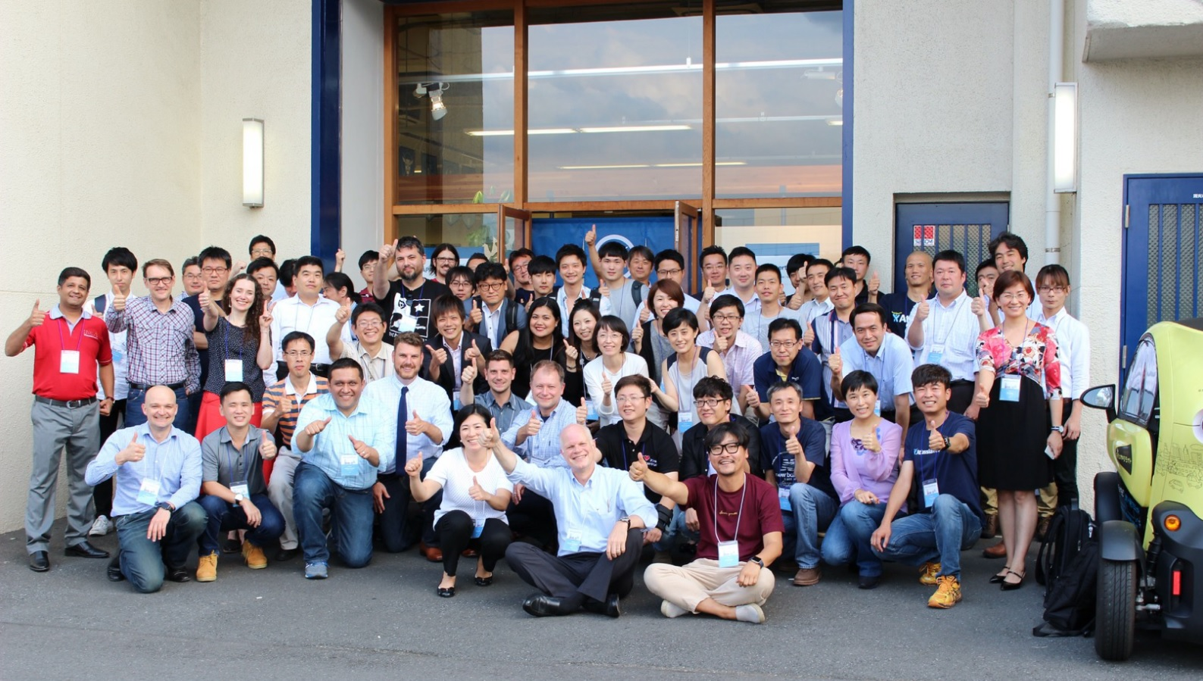
Yes!! We are expert .
For All Atlassian Produces

Slide 5


























Linksoft customer in Taiwan

Slide 6

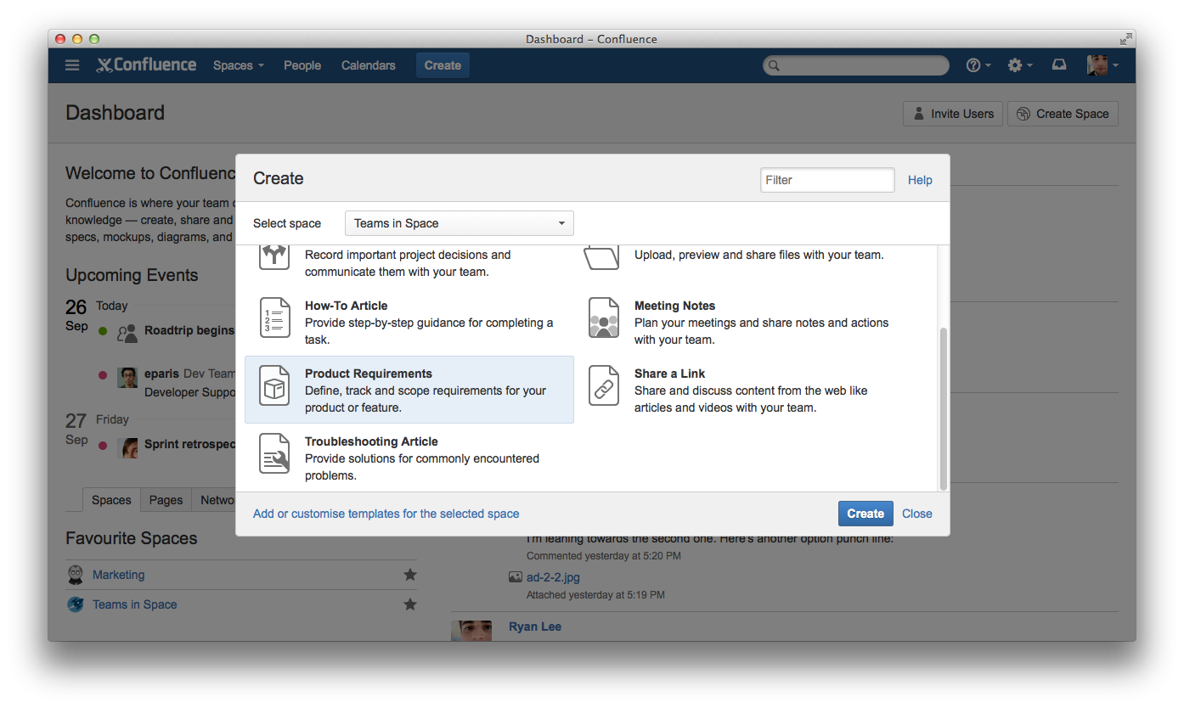
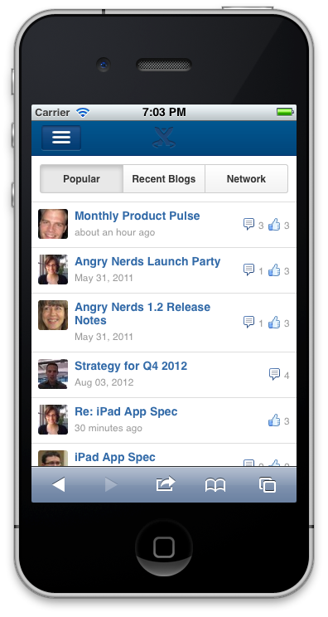
Where work becomes teamwork

Slide 7
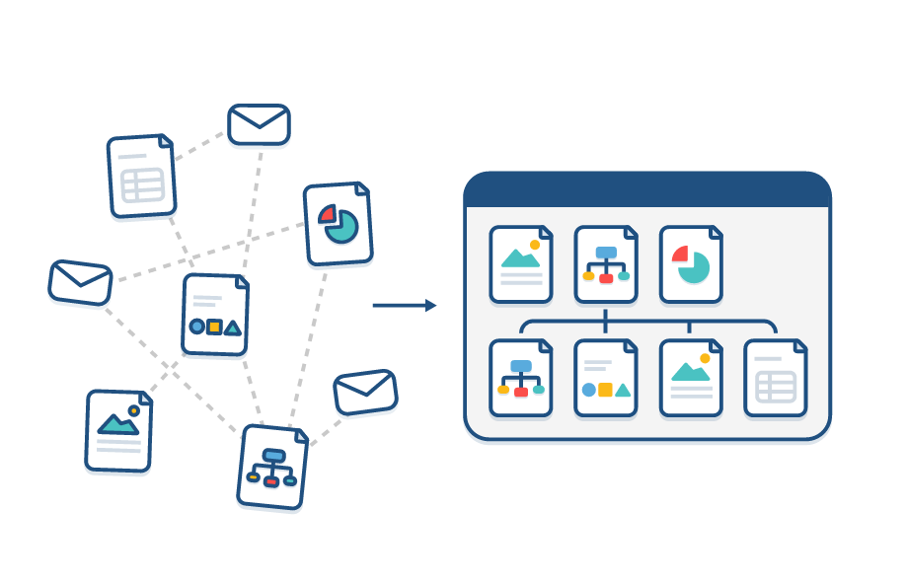
Centralize & Organize
提供每個部門、團隊或專案一個專屬的空間（Space）存放資訊 。Confluence讓資訊有系統的歸檔及方便檢索.
www.linktech.com.tw

Slide 8

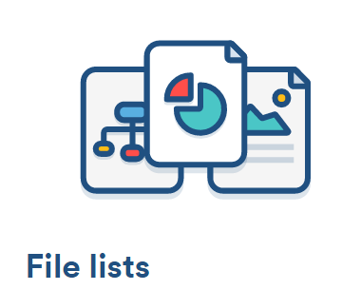

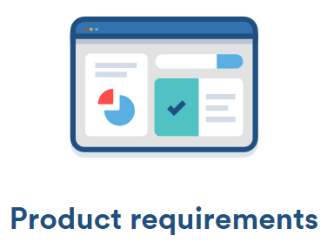
Best templates to get you started
清楚的呈現會議流程、執行項目任務，提高會議效率。
根據您的專案分類或分享您所需的檔案。
提供文件分享及知識傳承的整合平台。
結合JIRA issue，
每個使用者能獲得所需的完整資訊。

Slide 9











Why we win
1. 最佳的整合環境
+
2. 團隊協作、知識分享、學習可在同一平台上達成
3. A trusted and extensible collaboration platform.

Slide 10
Confluence Overview
完整的頁面紀錄
修改與操作紀錄,頁面版本快速恢復
企業級線上百科（Enterprise WiKi）
強大的資料中心，提供文件管理、內容管理
高度彈性權限
可依據Space / Page設定權限
超強內容搜索
有系統的整合JIRA issue
文件內容搜索(Word .Excel . PDF)
直覺式編輯環境
Rich editor / Powerful Macro / Template
具備權限與公開彈性的團隊行事曆
可與您的Outlook.iCalendar.Google整合

Slide 11
Save your issue to KM
Issue
知識管理系統 / Document Center
Enterprise WiKi
專案管理
工時.人力
Scrum /
Kanban
即時線上客服平台
IT Services
ODM/OEM
及時提供關聯性資料

Slide 12
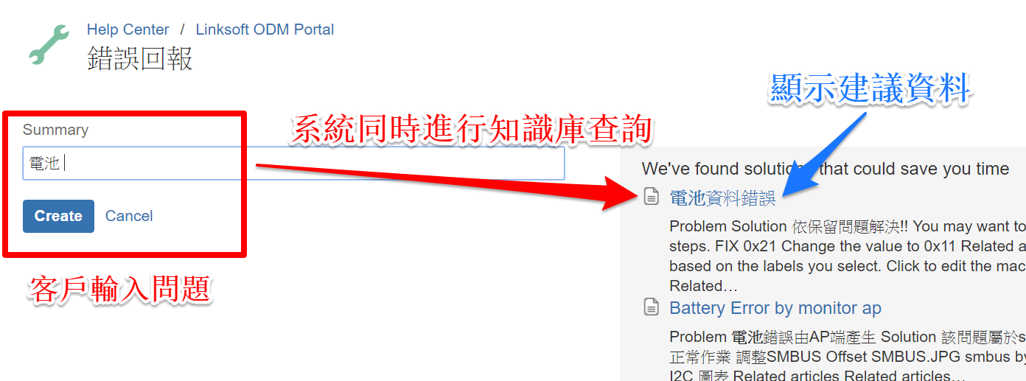
處理過的案子都成為知識庫內容

Slide 13
Features

Slide 14
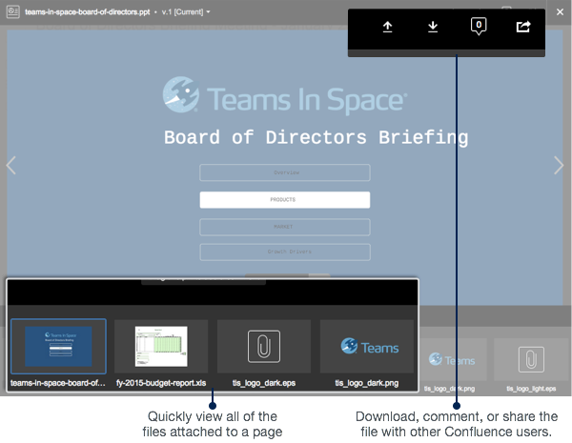
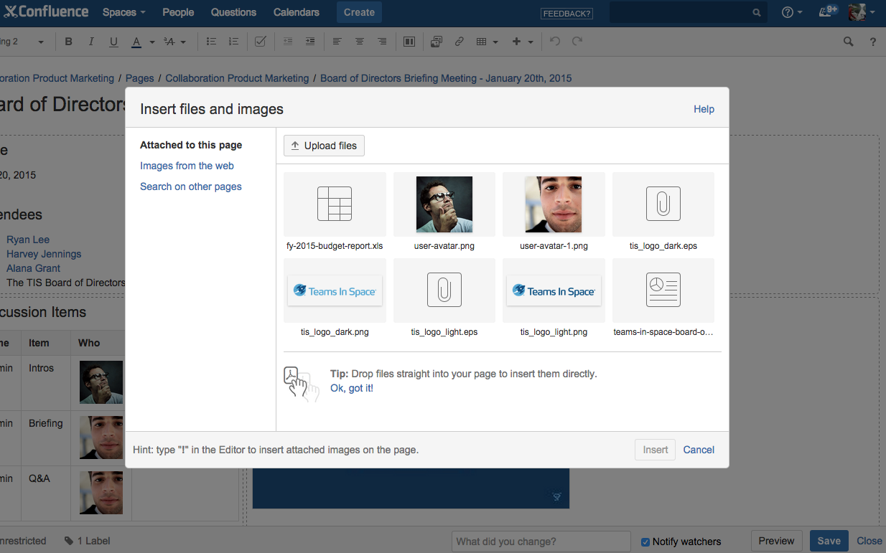
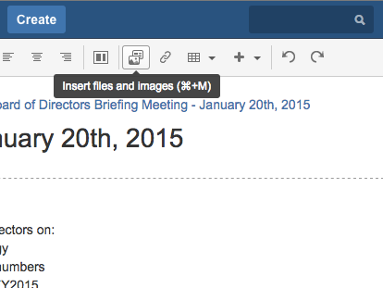
1. Share and view files in one place
Notes:
First, users can now share and view files in Confluence.
(click) As shown earlier they can drag and drop a file or image to add it to a Confluence page, but they can also make use of the new files button in the editor toolbar.
(click) This button populates the ‘insert files and images’ dialog where its easy to manage files on your page, on the web, or on other pages in Confluence.
(click) Then when looking at a file, you get the all-new rich file previewer - capable of previewing a variety of image file types, Office file types (including Word, Excel and PowerPoint) and PDFs. You can quickly go through the files, download them, browse the versions, upload a new version, and share an individual file with teammates just like you would a Confluence page. It’s a really exciting experience our development team has been working hard on.

Slide 15
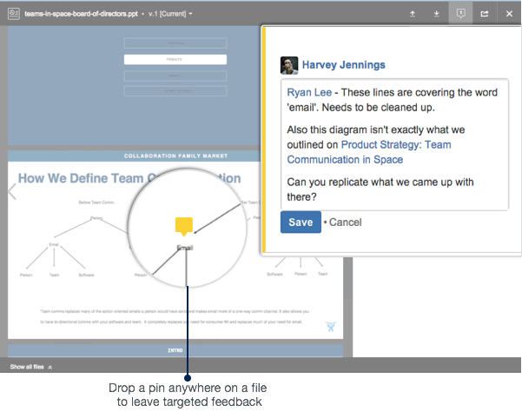
2. Add feedback inline on files…
Notes:
When looking at a file in the previewer you can start leaving feedback by dropping a pin anywhere on the file. You can see the yellow pin in the pop-up circle. Once this pin is dropped, it triggers an inline comment where you can leave feedback using text, @mentions, page and file links, and emoticons. As mentioned this is such a useful experience and really exciting particularly for users that spend a lot of time working on Spreadsheets and PowerPoints.

Slide 16
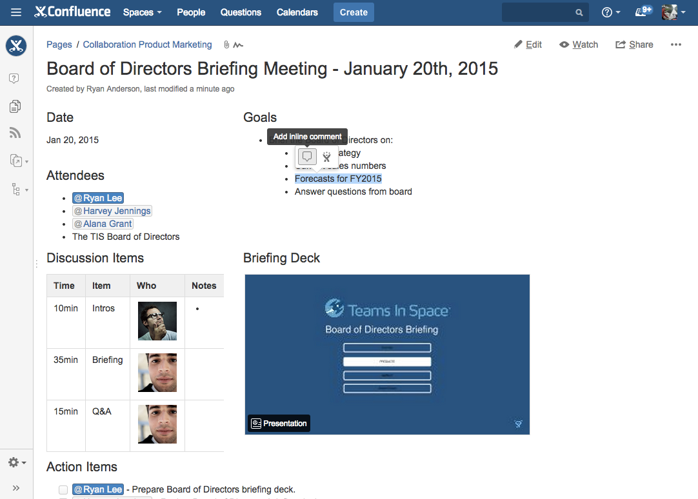
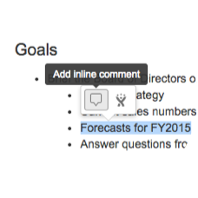
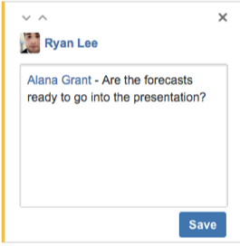
…and pages too
Notes:
We also made it possible to give inline feedback on pages too.
(click) All you need to do is highlight a word, sentence or paragraph, and it will trigger a small dialog. When you choose the comment button, it will trigger an inline comment. This is so awesome for reviewing long documents where previously you had to constantly scroll up and down to read and leave feedback for the author.

Slide 17
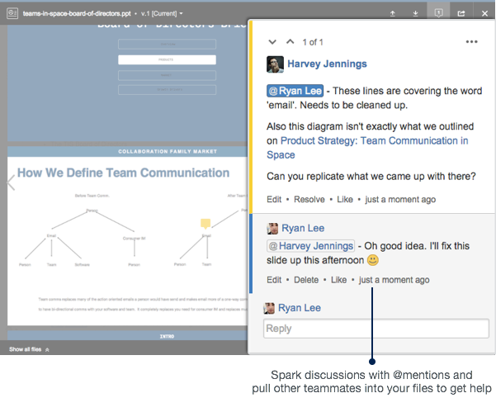
3. Discuss feedback
Notes:
As mentioned in the story, inline comments are great for having discussions and clarifying and improving feedback. If you’ve ever tried to discuss feedback via email - its a complete nightmare.
We’re really excited about how much better this experience is for people that work with files everyday.

Slide 18
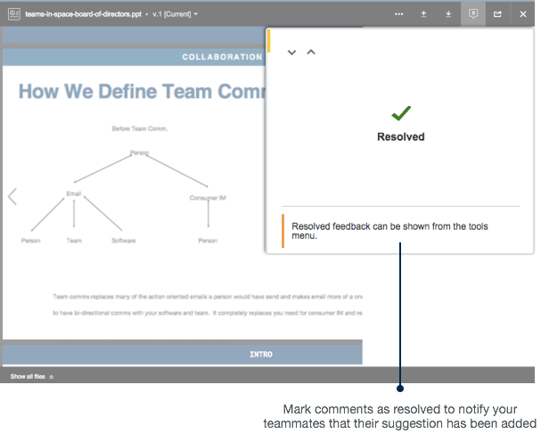
4. Close your feedback loop
Notes:
Finally - users can now resolve comments which triggers a notification to keep the contributors up to date about what suggestions were incorporated.
To take a step back - we built this feedback loop because customers were asking about it - but also we felt it was a critical to increase the value for Business Teams who regularly work with files. This is an important bridge into Confluence for people that use files everyday.

Slide 19
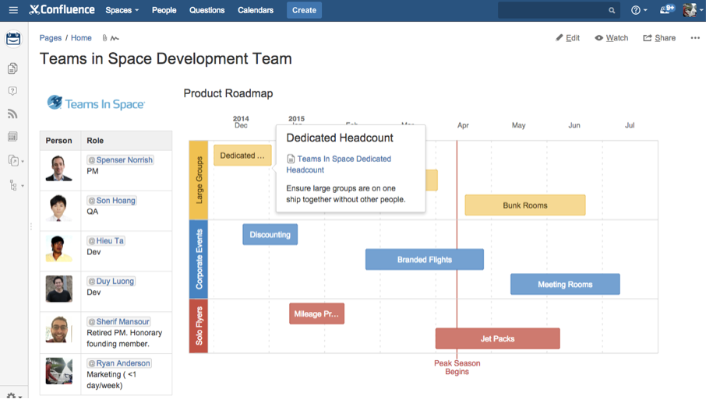
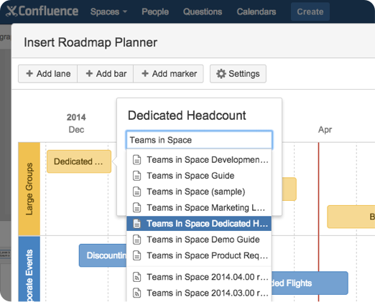
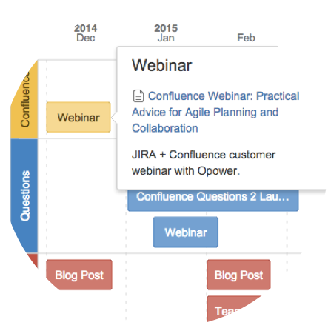
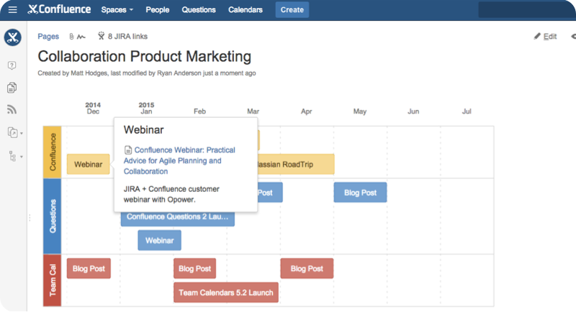
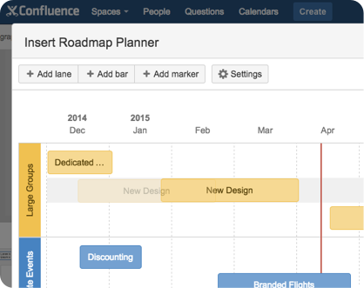
The Roadmap Planner macro
Changing your plans is
as easy as drag and drop.
Link your plans to relevant
pages so there’s always context.
Notes:
The roadmap planner macro is awesome for visualizing product, project, and team roadmaps with a light-weight timeline. We were often hearing about how product and project owners wanted a way to communicate a plan to stakeholders in a way that made sense to everybody. People were tired about being asked ‘what’s coming next?’ or ‘when is this shipping?’.
(click) The roadmap planner macro is great because you can build out an entire schedule using lanes, bars, and markers and even add more context to work in flight by linking to relevant Confluence pages.
(click) It’s also easy to adjust by just dragging and dropping bars on the timeline.
(click) And lastly - i want to clarify that the roadmap planner macro isn’t just for product roadmaps. Every team has the need to communicate what they are working on a high-level timeline. We use it on the Confluence marketing team to communicate our quarterly plans and it works really well for us.

Slide 20
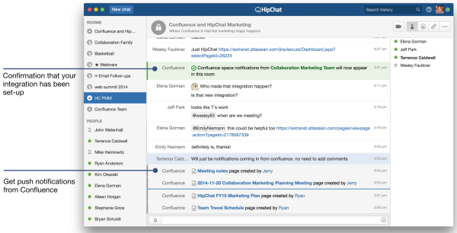
HipChat Integration
Notes:
HipChat is critical to Atlassian’s success and we are doing everything we can to work better with HipChat. In 5.7, you can integrate Confluence and HipChat to connect Confluence spaces and HipChat rooms which delivers push notifications in real-time from Confluence.
We have a lot of exciting stuff on the roadmap to build this integration out - this is only the beginning.

Slide 21
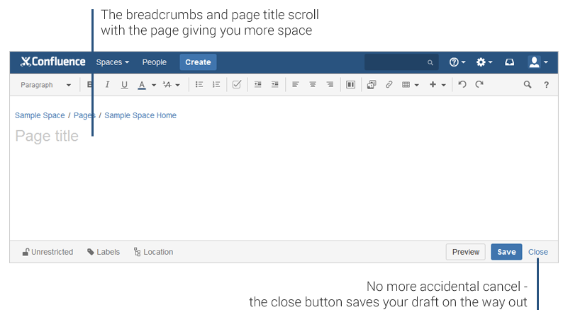
A new space-saving editor
Notes:
Lastly - we simplified our editor by moving the breadcrumbs and page title into the editor. We felt this was more intuitive, but also saved a ton of space and gave more room to the editor. It’s also an important step for us as we redesign the editor to make room for inline comments in the editor.
Another cool addition is that we replaced the ‘cancel’ button with the ‘Close’ button to avoid accidental cancels that didn’t save a draft of your page.

Slide 22
Confluence Feedback Loop

Slide 23

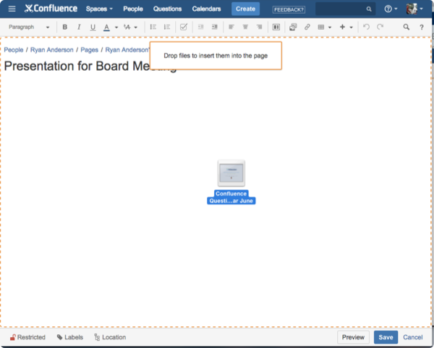

Confluence Feedback Loop
在同一個平台檢閱或討論工作
檢閱和討論你的工作– 專案計畫、Excel表單、PowerPoints、或其他檔案 – 上傳至你的Page中.
即時性線型式團隊討論機制，使團隊內部討論不會有遺漏並且將團隊效益發揮到極大化。
Claire 在Confluence上分享了一個PowerPoint.
無論是 – Office文件、圖片、檔案 – 和您的團隊在同一個地方分享。
而你只需使用拖曳的方式就可將檔案上傳，系統會自動進行版本控制，所以不會有下載到舊版本的問題。
Notes:
I wanted to quickly walk you through the basic marketing story.
Confluence 5.7 is focused on giving users a new feedback loop where they can review and discuss work in one place. Giving feedback on a page or file is one of he most complicated processes during a person’s work day. It typically involves multiple versions of PowerPoint presentation with a variety of names, a long and hard to follow email chain, and a ton of context switching as both the reviewer and the author have to jump back and forth between a file and its feedback to reference suggestions. It’s exhausting. Confluence 5.7, we want the feedback, discussions and resolutions happening all in one place.
(click) So the story starts with Claire uploading a PowerPoint to a Confluence page so she can share it with her team and trust that it’s automatically versioned as newer versions are uploaded.

Slide 24

Confluence Feedback Loop
在同一個平台檢閱或討論工作
檢閱和討論你的工作– 專案計畫、Excel表單、PowerPoints、或其他檔案 – 上傳至你的Page中.
即時性線型式團隊討論機制，使團隊內部討論不會有遺漏並且將團隊效益發揮到極大化。
Jeff查看了PowerPoint並加上了他的留言
你可以快速的使用rich previews瀏覽線上檔案內容，並提供更方便的討論方式。 你只需要利用簡單的標記，就可在Comment中留下問題或意見，不需要使用其他程式或是透過Email討論。
Notes:
(click) Claire’s teammate Jeff can then view the presentation with an all-new file previewer. This is perfect for Jeff because he doesn’t have to download the PowerPoint to see it, he just opens it up right in his page.
But Jeff can go one more step and click to add a pin anywhere on the powerpoint to give feedback that has context. Dropping a pin will trigger an inline comment where Jeff can give his feedback, @mention other teammates to get their help, or even link to other Confluence pages or files to share more information. It’s so much easier to keep the conversation and feedback on the file, rather than siloing it in an email chain.

Slide 25

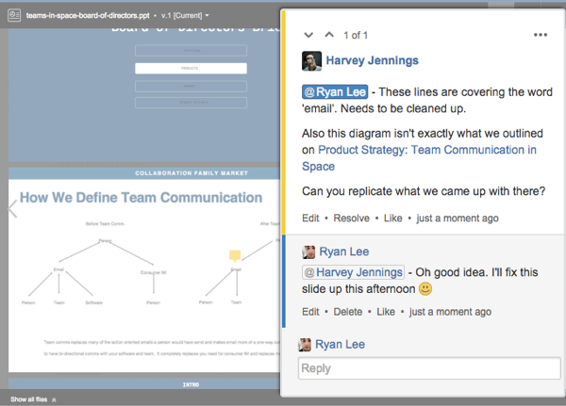
Confluence Feedback Loop
在同一個平台檢閱或討論工作
檢閱和討論你的工作– 專案計畫、Excel表單、PowerPoints、或其他檔案 – 上傳至你的Page中.
即時性線型式團隊討論機制，使團隊內部討論不會有遺漏並且將團隊效益發揮到極大化。
Jane 加入了這個討論
利用Confluence上的討論機制，可有效避免問題的重複，也可以在不明確的回答中進行討論以釐清問題。有效的降低個人工作負
擔並提高團隊工作效益。
Notes:
Jane can then chime into the discussion as she was called in by Jeff. What’s so powerful about having discussions on a file is that giving feedback can be collaborative and also ensure that no one is duplicating work. So as an author you’re avoiding your teammates giving redundant feedback, feedback is given on the most current version of a file, and your getting the highest quality feedback as your reviewers can work together to build off one another. It’s less work for you and less work for your team too.

Slide 26

Confluence Feedback Loop
在同一個平台檢閱或討論工作
檢閱和討論你的工作– 專案計畫、Excel表單、PowerPoints、或其他檔案 – 上傳至你的Page中.
即時性線型式團隊討論機制，使團隊內部討論不會有遺漏並且將團隊效益發揮到極大化。
Claire 修正了問題，並完成他的簡報
綜合團隊成員的意見，並修正問題，使你的簡報更加完美。 Confluence也會在Version History中留下這個討論記錄。
Notes:
Finally, the best feedback loops are the ones that can actually be closed off. Once Claire has incorporated feedback, she can resolve it which triggers a notification to the contributor that their suggestion was added to document - closing the loop.
We are really excited about this functionality in Confluence and we think our customers are going to love working with files in Confluence because now they can easily upload, view, comment, and version their files in ways they never could before.

Slide 27
Public . Private . Sync and Mapping ever schedule you want

Slide 28
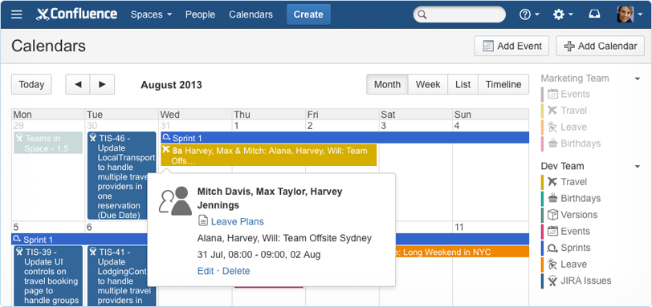
SHARE CALENDARS

Slide 29
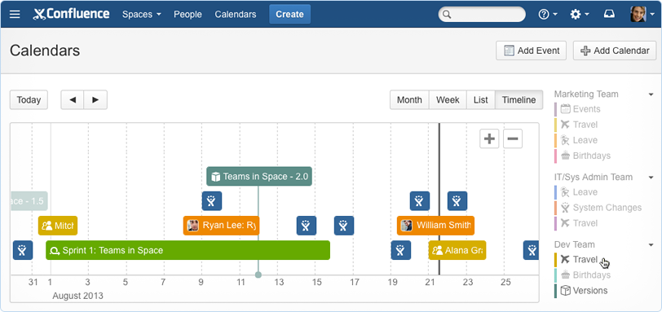
CUSTOM VIEWS
選擇所要關注的行程或事件進行查閱

Slide 30
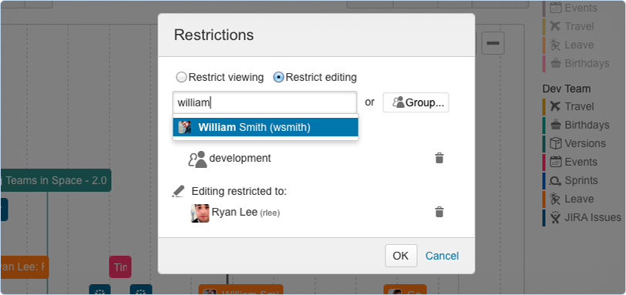
Secure your calendars
觀看或編輯限制條件，可以更清楚的知道誰可以編輯檢閱團隊行事曆

Slide 31
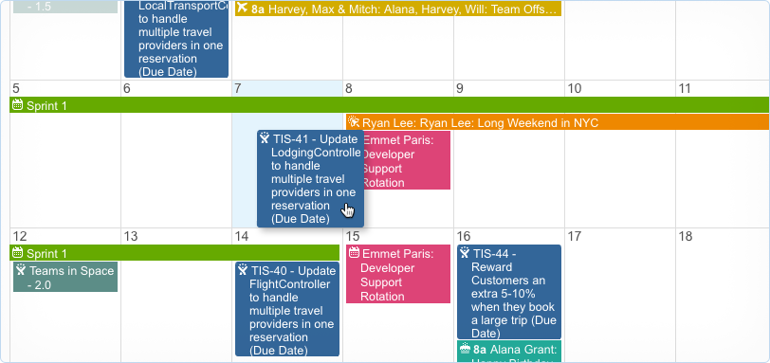
Reschedule with ease

Slide 32
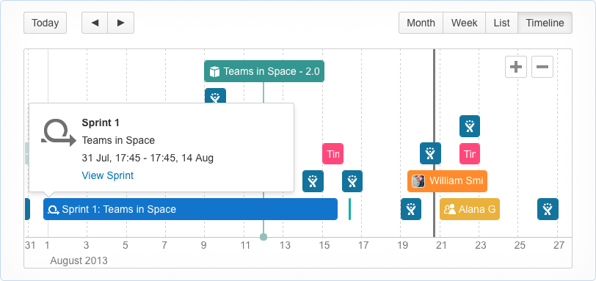
Agile planning
把預定期程與團隊行事曆一併檢閱，可以有效的降低潛在的衝突，並可將此影響的衝擊降到最低，不至於影響到下一個期程

Slide 33
Competitive Landscape

Slide 34
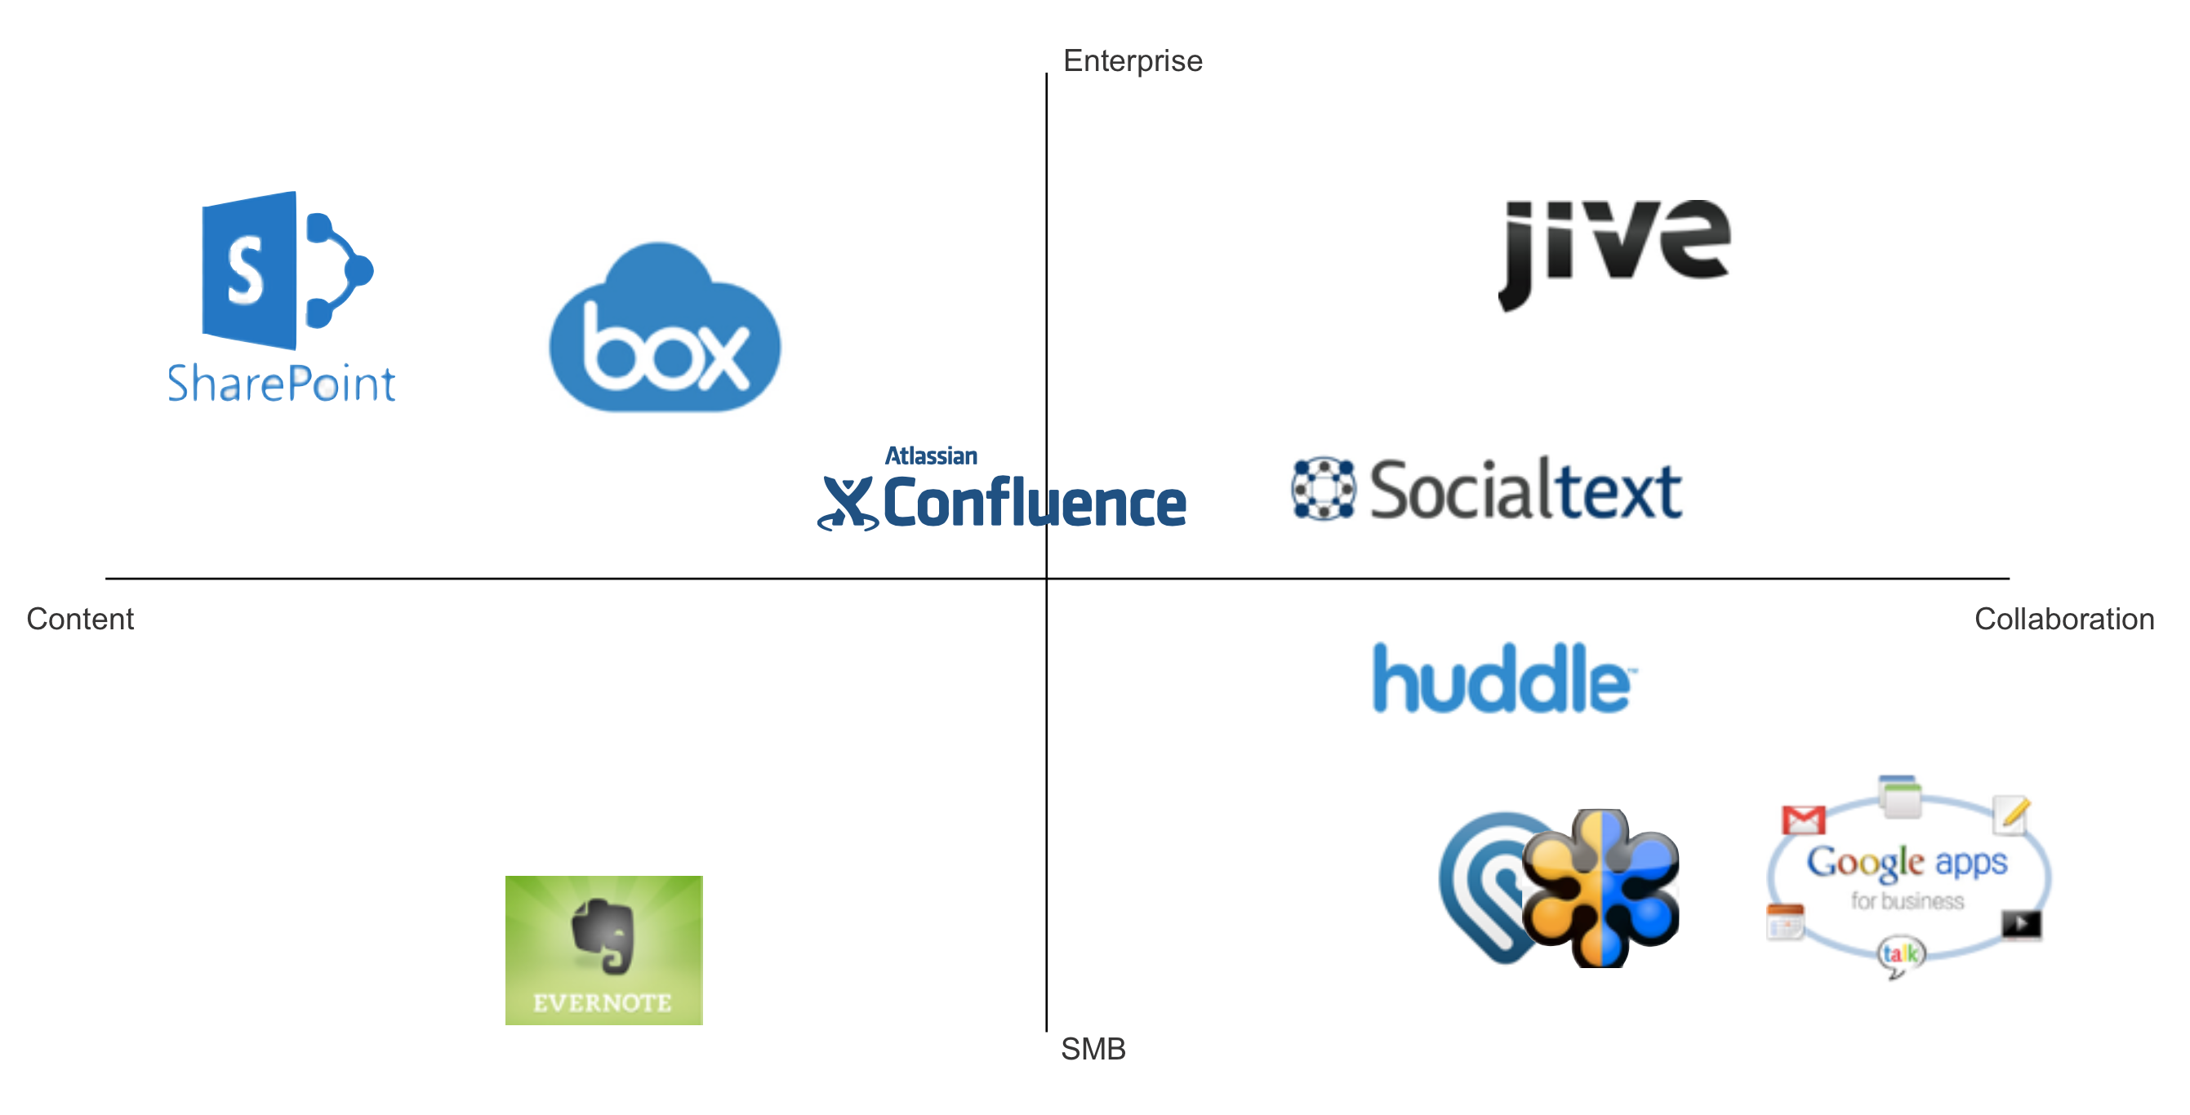
Who is on our radar?

Slide 35
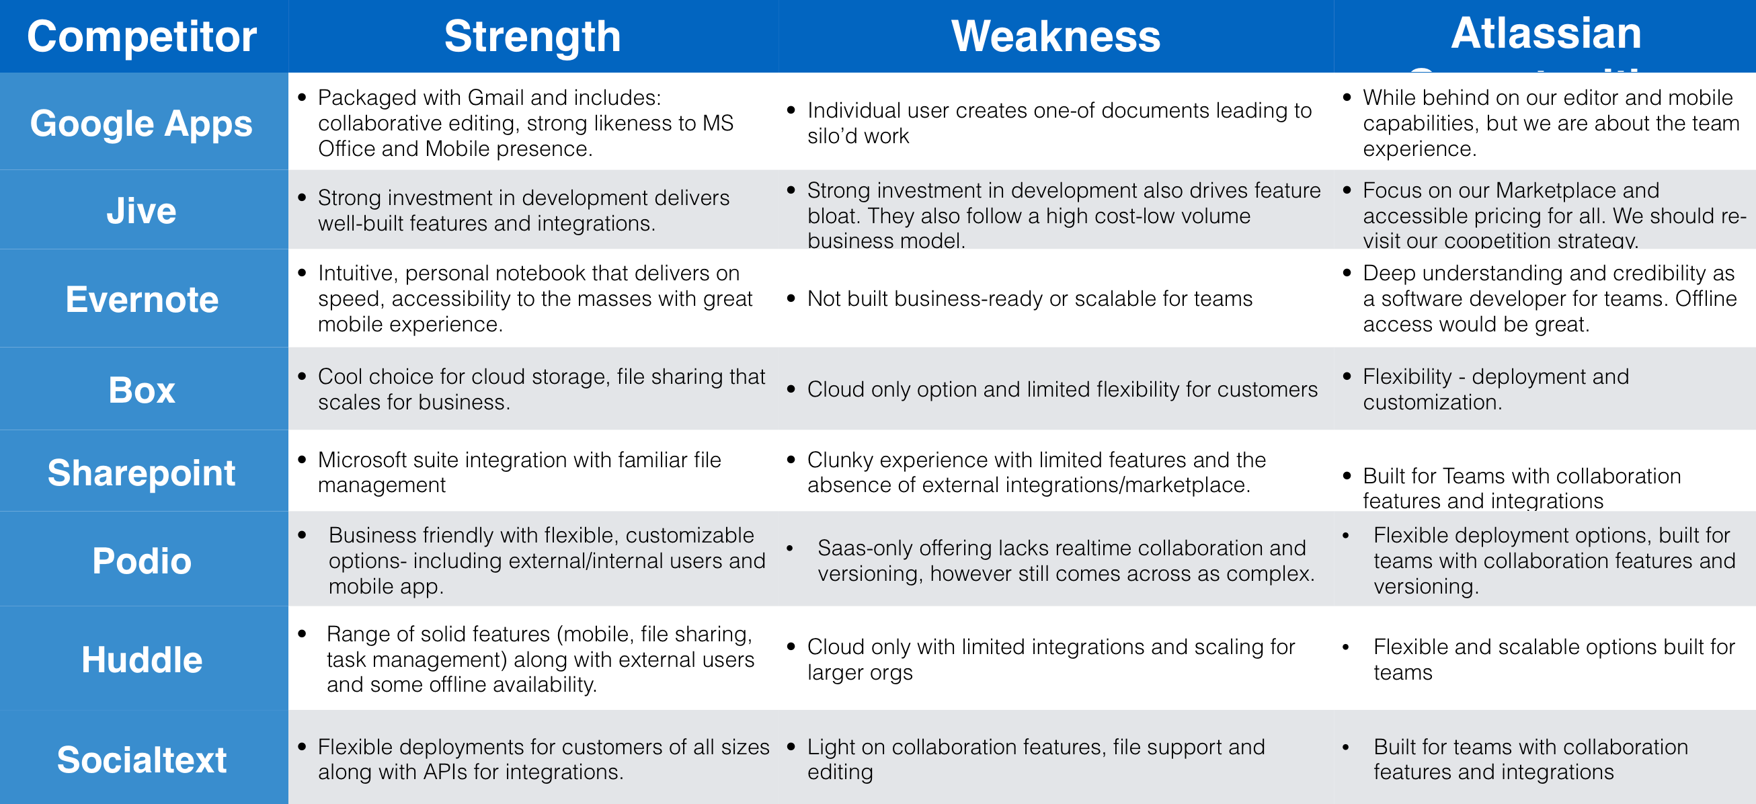
How We Compare

Slide 36
Technical support & training

Slide 37
Technical support & training
原廠技術支援
項目 | 時間
Q&A by email or JIRA support system | 購買後一年.由JIRA原廠開出License時間起計

Slide 38
What’s Consultant Hours
全方位企業級解決方案
Consultant Package
系統建置/管理/應用教學
介面與功能客製化工程與教學(AUI/SDK)
跨系統工程諮詢與教學(REST API / SDK)
IT 方案諮詢與工程

Slide 39

導入流程說明 – Phase I
Phase I Class : 建立JIRA 系統關鍵概念,使客戶擁有自行管理/建立專案能力,並協助設計出可上線系統
需求訪談
範圍目標:一個特定專案或是一個部門的專案流程系統化上線
課表 & 執行計畫
客戶簽署後,開始執行
Reschedule
&
Plan
Phase I 課程與顧問活動
執行期間2W~3W (最低建議1W)
友環技術支援:
以電話.電郵.技術文件為主,視情況決定是否使用教育訓練時數至現場服務
內部推廣
內部需求修正

Slide 40
導入流程說明 – Phase II
範圍目標:全公司或其他BU進行實際運作教學.
1.確認新的導入單位
2.確認是否納入新的服務模組 如:KM . Test Management
Phase II Class : 將Phase I實際上線系統經驗與操作,推廣至全公司,並決定後續導入工作
After Phase I
Sync meeting
調整課表 & 執行計畫
確認是否進行計畫變更 ?
Reschedule
&
Plan
Phase II 課程與顧問活動
執行期間2W~3W
友環技術支援:
以電話.電郵.技術文件為主,視情況決定是否使用教育訓練時數至現場服務
內部推廣
內部需求修正

Slide 41
導入流程說明 – Phase III
Phase III Class : 針對客戶新的階段需求 如更多單位規模導入,或客製化需求開發,進行課程與顧問活動
After Phase II
Sync meeting
調整課表 & 執行計畫
確認是否進行計畫變更 ?
Reschedule
&
Plan
Phase III 課程與顧問活動
Iterate Phase
執行期間3W~4W (最低建議3W)
統計與規劃出需客製化工作
友環技術支援:
以電話.電郵.技術文件為主,視情況決定是否使用教育訓練時數至現場服務
內部推廣
內部需求修正

Slide 42






Q&A

