Slide 1
THE JFROG PLATFORM LIVE DEMO
講師：Linktech Inc. - Vic

Slide 2
The JFrog Platform Overview
JFrog Artifactory
JFrog Xray
JFrog 優勢
Integration with Atlassian
Q&A

Slide 3
Lets DevOps ! 我們專注於整體軟體工程解決方案!
Hi ! We are Linktech !

Slide 4
我們提供最完整的敏捷開發案

Slide 6
Build your DevOps Chain
從需求到編譯不ㄕ，任何流程自動化與程式碼掃描
為您打造全方位企業 DevOps 團隊

Slide 7
Linktech customer in Taiwan

Slide 8
JFrog Platform Overview

Slide 9
JFrog Platform Overview

Slide 10
Why Jfrog ?

Slide 12
Artifactory & Xray 一次解決所有煩惱

Slide 13
Xray可以監控開發中每個階段進行漏洞偵測

Slide 14
UNLIMITED USERS. FLEXIBLE PLANS

Slide 16
JFrog Architecture

Slide 17
Synchronize multiple locations

Slide 18
JFrog Artifactory

Slide 19
UNIVERSAL PACKAGES. CONTINUOUS UPDATES.
As the world’s first universal repository, JFrog Artifactory is the mission-critical heart of the JFrog Platform functioning as the single source of truth for all packages, container images and Helm charts.

Slide 20
JFrog Artifactory Feature
Projects management
Federated Repositories
Accelerate your development workflow
Manage full artifact lifecycle

Slide 21
現在可以直接透過JFrog Artifactory管理所有類型Artifact Repository

Slide 22
並且透過JFrog Artifactory也可進行佈署用Artifacts(.war等)管理

Slide 23
JFrog Artifactory Repository Management

Slide 24
JFrog Artifactory Repository Management
Local Repository
Virtual Repository
Remote Repository

Slide 25
JFrog Artifactory Build
Get Maven Repository
Virtual
Local
Remote

Slide 26
JFrog Artifactory Artifact Deploy
Upload Artifact
Local

Slide 27
JFrog Xray

Slide 28
Multilayer analysis of your containers and software artifacts for vulnerabilities and license compliance issues

Slide 29
Xray Feature
Support NVD & VulnDB
DEEP RECURSIVE SCANNING
COMPLETE IMPACT ANALYSIS
Security at SPEED

Slide 30
確保程式品質及資安控管建議

Slide 31
Xray可以監控開發中每個階段進行漏洞偵測

Slide 32
JFrog Xray可在所有階段進行漏洞掃描

Slide 33
Jfrog 優勢

Slide 34
Jfrog 主要優勢
它是一个通用 Artifact Repository 管理庫
跟市場主流幾套 CI 工具有良好的整合規劃
內建 AQL 語法提供强大的搜尋功能
可管理 Artifact 完整生命週期
支援 DevOps 完整流程規劃
支援漏洞掃描，確保 Artifact 可安全使用
提供原廠支援並且持續更新，使用上有保證

Slide 36
User story in Bank

Slide 37
金融業開發外包現狀

Slide 38
Integration With Atlassian

Slide 39
Atlassian DevOps
1.
Create Branch
6.
Issue
2.
Code Commit & Issue Sync
Auto Trigger CI/CD &
Get Repo & Code data
7.
3.
Create Pull Request
4.
Build info return & Scan Info
Get Artifact Repository & upload Artifacts & Scan Vulnerability
5.

Slide 40
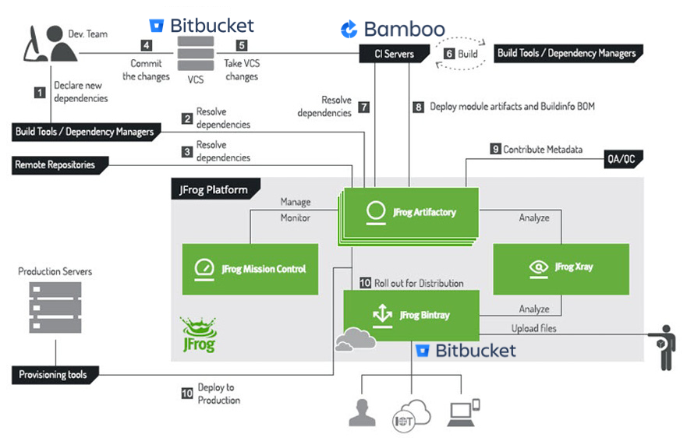

Slide 41
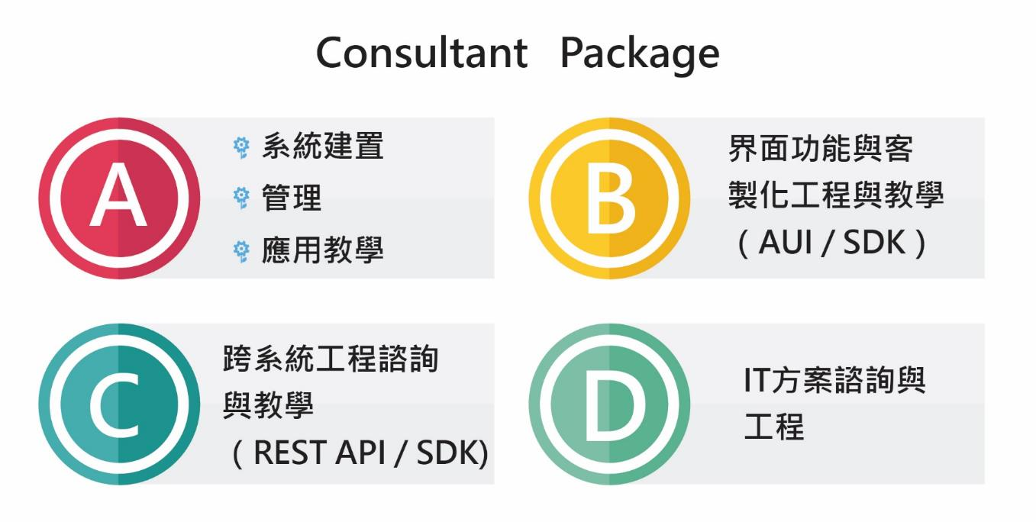
What’s Consultant Hours

Slide 42
友環企業專業的顧問輔導
擁有最多大型企業導入經驗,講師經驗涉及各大產業界.

Slide 43
各階段導入工作 – 輔導案開始

Slide 44
Q & A

