Slide 1
SpiraTest® - 2016 Product Information
Requirements, Test Management and Defect Tracking in One Package

Slide 2
Objectives
After viewing this presentation you will:
  Understand the challenges involved in managing the testing lifecycle of a project
  Have a strong grasp on the features provided by SpiraTest
  Have learned about the benefits of using SpiraTest to manage your quality assurance processes

Slide 3
Agenda
QA Testing Challenges
SpiraTest Overview
Feature Walkthrough
  Requirements Management
  Test Case Management
  Release Management
  Incident / Defect Tracking
Integration / Migration Options
  Use of automated testing tools
  Synchronization with external bug-trackers
  Migration from other systems

Slide 4
QA Testing Landscape
Traditionally, QA organizations use the following tools and systems to manage their testing:
  Requirements stored in MS-Word documents or MS-Excel spreadsheets
  Test scripts for user acceptance testing stored in MS-Word, MS-Excel with results recorded on paper and transcribed manually back into the spreadsheet
  MS-Access, MS-Excel or standalone web-based bug-tracking system for tracking issues and defects
  Automated testing is done with a variety of tools depending on the platform and language being tested (Java vs. .NET, web vs. client-server)

Slide 5
QA Testing Challenges
This leads to the following challenges:
  Processes are ad-hoc and not repeatable across projects
  There is no visibility between test cases, requirements and defects. How do you know when you are truly ‘done’?
  Measuring progress and productivity during testing is time consuming and difficult
  It’s hard to share information across the project and get real-time metrics regarding the quality of the system being tested
  There is no central repository of test results from all sources – both automated and manual
SpiraTest is explicitly designed to address these issues and provide an integrated solution…

Slide 6
SpiraTest® Overview

Slide 7
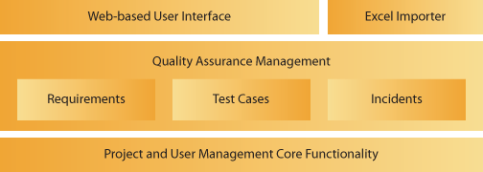
Product Overview
Instead of having to buy separate requirements capture, bug tracking and testing tools, SpiraTest provides a complete Quality Assurance solution in one package.
SpiraTest manages your project's requirements, tests, bugs and issues in one environment, with complete traceability from inception to completion.

Slide 8


Integration your JIRA stream in your workflow
+
Unit Testing Frameworks
Requirements Management Systems
Automated Testing Tools

Slide 9
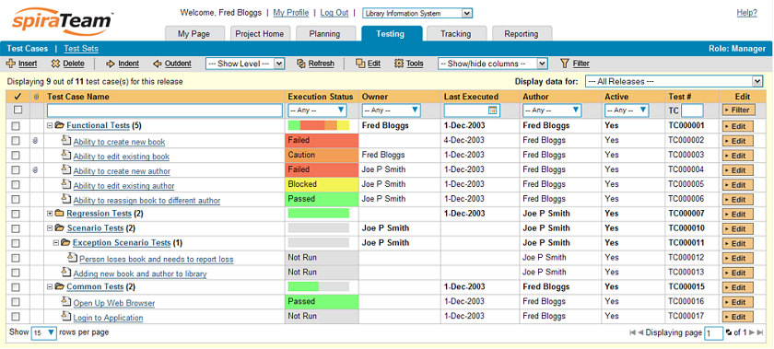
Dual system Cross Solution
In your JIRA workflow
Auto link be your Test Case

Slide 10
Why Choose SpiraTest?
The top three reasons that our customers choose SpiraTest over other solutions are:
  It is a complete solution that includes requirements management, test case management, release management and defect tracking all fully integrated from day one.
  Highly intuitive web application that provides a complete picture of a project’s status and health yet requires only a web-browser.
  Ability to leverage your existing technology investments. SpiraTest integrates with many automated testing solutions and third-party defect-management systems.
In addition, we provide superb technical support that ensures that enquiries and questions are dealt with in a timely and professional manner.

Slide 11
Feature Snapshot
Listed below are some of the many great features that makes SpiraTest quality assurance software the leading choice for companies and organizations worldwide:
Link bugs to test steps during test execution
Drill down from requirements to tests and incidents
Personalized dashboards and customizable reporting
Web-based graphs and reports
Intuitive Web Interface (pure HTML)
Fully customizable workflows and field values
Manage requirements, features and use-cases
Create, edit and execute test-cases
Track bugs, enhancements, risks and issues
Map tests to requirements to track coverage
Clean and powerful user interface
Support for template test cases

Slide 12
Competitive Landscape
We believe that SpiraTest offers an unbeatable combination of capability and affordability:
Source: Inflectra Corporation, 2010
Niche Players
Challengers
PassMark
SpiraTest
ApTest
QaTrac
TechExcel
Testuff
Affordability
TestRail
IBM Rational
Zephyr
HP QC/ALM
MicroFocus
Uncompetitive
Incumbents
Breadth of Features / Capability

Slide 13
























Representative Customers
The following are some of the organizations who are using SpiraTest to manage their quality assurance processes:
Energy & Industrial
Financial & Business Services
Government
Information Technology
Healthcare & Bio-Technology
Telecommunications
Retail & Consumer Goods
Transportation & Hospitality

Slide 14
Testimonials
"... This is a fantastic piece of software, it was easy to put in place on our own server, has run faultlessly since its initial setup and any problems we encountered were taken care of by Inflectra's support very quickly.
Allows multiple ways to setup tests to match different workflows. provides a very good reporting overview to help clarify what is going on with testing. ...“
- Kristiaan Davies of Source Insurance Ltd.
“…Good and very useful application for managing testing. I would recommend it for everyone. Useful in managing multiple projects and groups. Our team members like the application and we are able to track progress. From the click of a button, I am able to know what everyone is working on...“
- Silas Oswe of Kentrade.
"...I would like on behalf of Conversive to express my thanks to your professionalism, timely responses and all support you have been providing to us since the time we took SpiraTest into test run. This is greatly appreciated and makes everyone here at Conversive confident that we have chosen a great product for our QA needs and that we will be using it for many years to come...“
- Ivan Milosevic of Conversive, Inc.

Slide 15
Introduction to QA using SpiraTest (1)
The first step is to define the project’s requirements matrix.
  This is a hierarchical list of all the features (both business and technical) that the system needs to fulfill
  They can be entered by hand, imported from Excel, or loaded from other tools like RequisitePro
  They can contain attachments, be cross-linked and have project-specific attributes
Define Requirements

Slide 16
Introduction to QA using SpiraTest (2)
Next, you should lay down the project’s release structure
  Include the major releases, minor releases and optionally builds and iterations depending on desired granularity
  You can now assign the different lower-level requirements to each of the releases so that it is possible to track the features planned per release.
Define Requirements
Develop Release Plan

Slide 17
Introduction to QA using SpiraTest (3)
Now you can create the test plan
  This consists of a hierarchical list of test cases organized into folders
  Each test case can be mapped to one or more requirements – this is used to specify the test coverage of the various requirements.
  Any requirements that have no covering tests are a project risk and additional covering tests should now be written
  The tests can be entered by hand or imported from Excel.
  Finally you can also map the test cases to the releases to provide regression testing capability
Define Requirements
Develop Release Plan
Create
Test Plan

Slide 18
Introduction to QA using SpiraTest (4)
At this point you can now perform the testing activities against the system under test:
  Create and assign test sets to the various testers. Each test set contains a group of test cases that need to be executed.
  Manual testing where users follow the steps in the test cases to ensure that the application works as expected
  Automated testing tools (e.g. unit tests, functional tests) can be executed in parallel to ensure that existing functionality works as expected
  The individual execution of tests cases are recorded as test runs that are linked to a specific test case and a specific release
Define Requirements
Develop Release Plan
Create
Test Plan
Test Execution

Slide 19
Introduction to QA using SpiraTest (5)
During the test runs, test failures can be used to automatically generate new defects:
  If the defect is detected during the execution of a test run, the test executor has the option of automatically creating a new incident that is linked to the test run in question
  If the defect is detected during free-form testing outside of a test run, the incident can be logged directly in the incident module
  Once the incident is logged, the lifecycle of the incident/defect can be tracked from detection to completion, with the developers, testers and other members of the team having full visibility at all times.
Define Requirements
Develop Release Plan
Create
Test Plan
Test Execution
Defect
Tracking

Slide 20
Feature Walkthrough

Slide 21
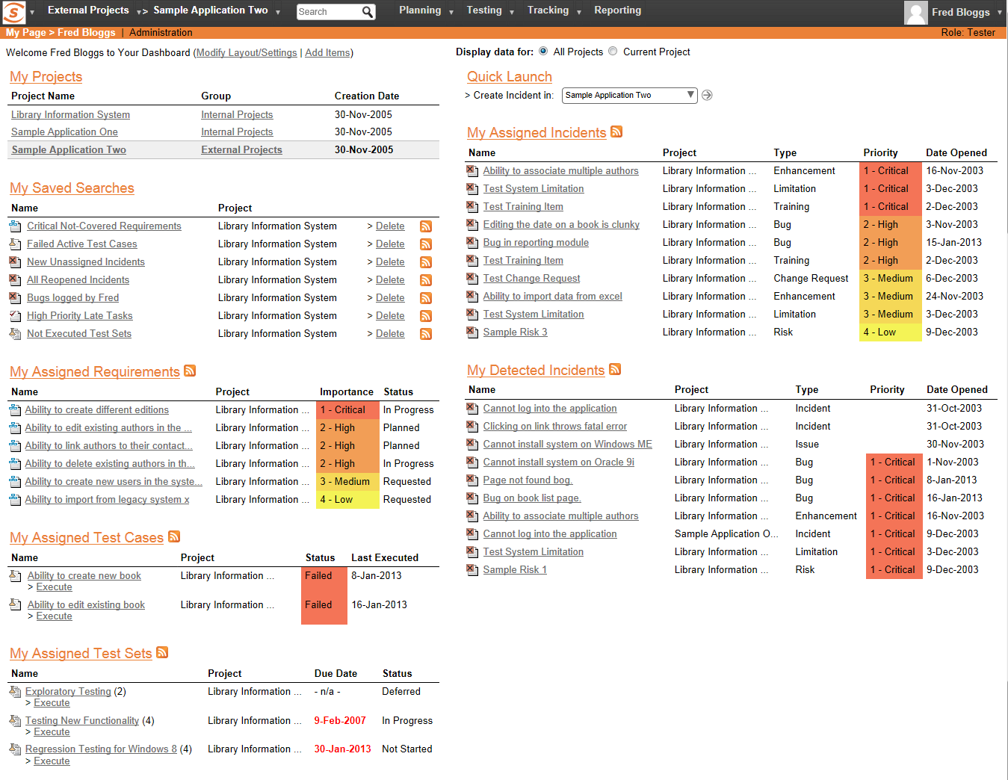
Personalized ‘My Page’
Upon login to SpiraTest, you are presented with a personalized ‘dashboard’ of all your key information, consolidated onto a single page for you to take immediate action.
RSS Feeds of your information are available.

Slide 22
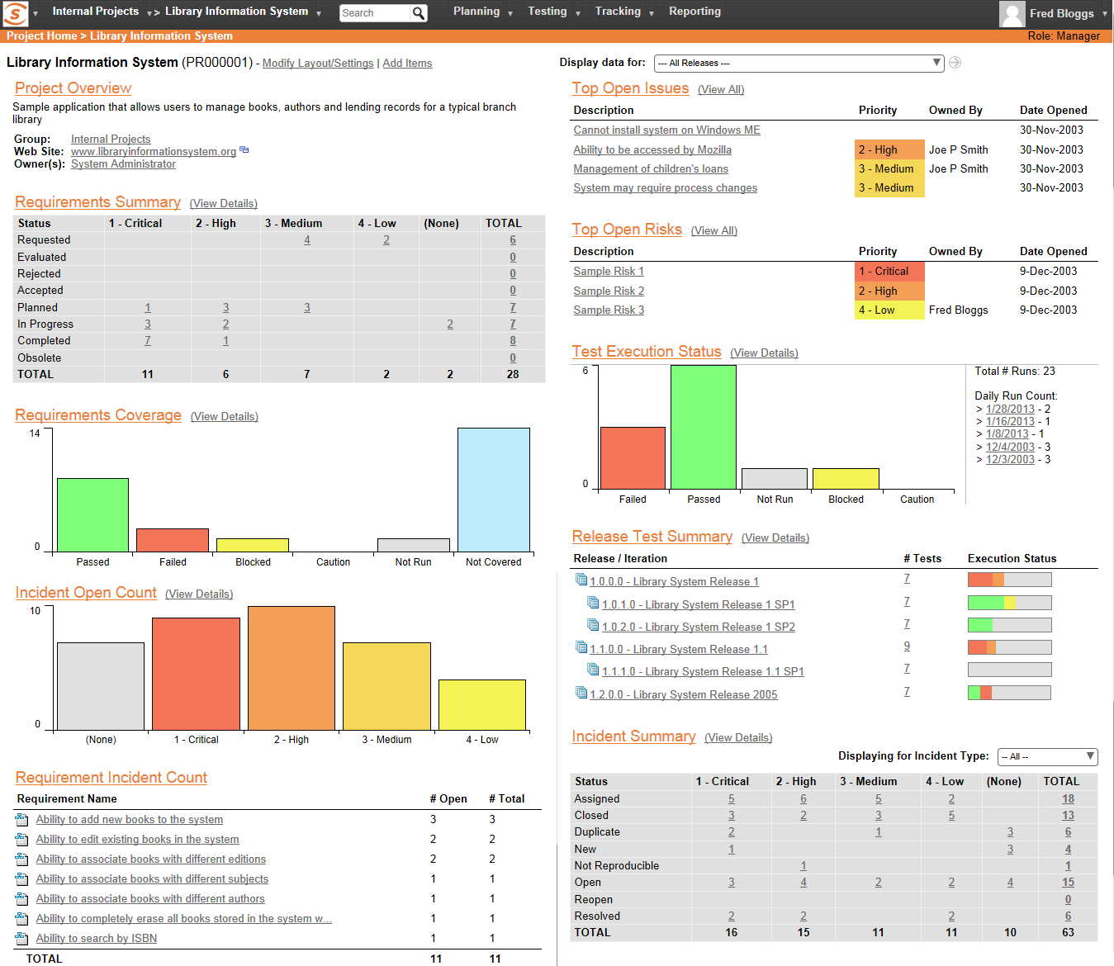
Project Home Page
Each project has a dashboard home-page that summarizes all of the information regarding the project into a comprehensive, easily digestible form.
It provides a “one-stop-shop” for people interested in understanding the overall status and health of the project at a glance.

Slide 23
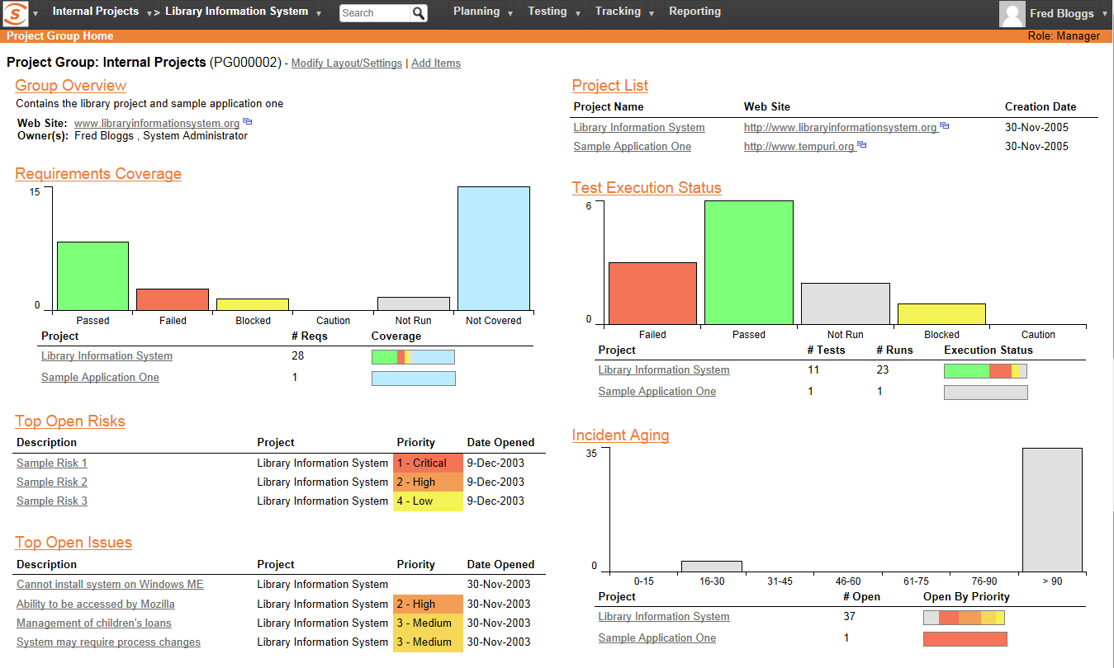
Project Portfolio Management
Projects in SpiraTest can be organized into Project Groups that belong to a common organization, customer or division. This allows you to view a summary project group dashboard that lets you view the aggregate status of the group as whole as well as compare the relative health of the different projects in the group

Slide 24
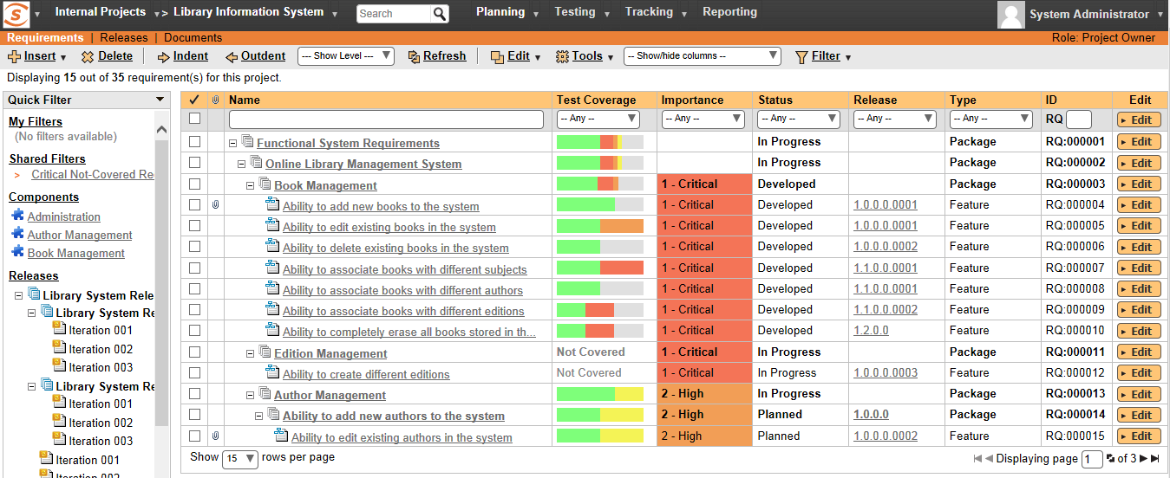
Requirements Management
You have the ability to create and manage project requirements, user stories and use cases in a hierarchical organization. Requirements can be prioritized, estimated and also associated with a specific release. Each requirement is displayed with its associated test coverage.

Slide 25
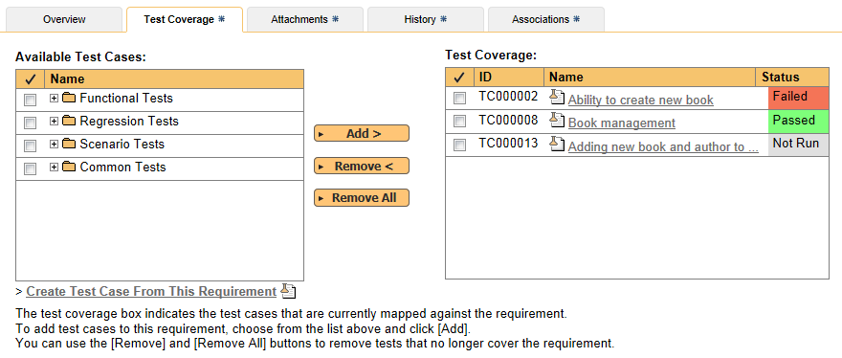
Requirements Coverage
Each requirement is mapped to one or more test cases that can be used to validate that the functionality works as expected.

Slide 26
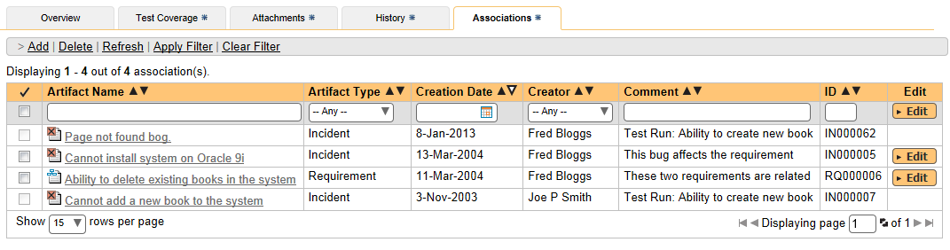
Artifact Associations
Each requirement can be linked to an unlimited number of other requirements or incidents, providing traceability between related artifacts. For example a change request incident that turns into a new requirement can be associated to preserve the pedigree of the requirement.

Slide 27
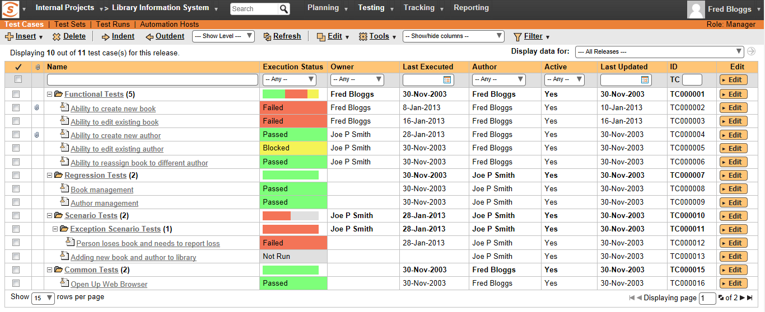
Test Case Management
SpiraTest provides the ability to create, edit and organize your test cases in a flexible hierarchical folder structure. You can move, copy and filter the test cases according to a variety of criteria. Each user can choose which columns are displayed, and the system allows the saving of common queries.

Slide 28
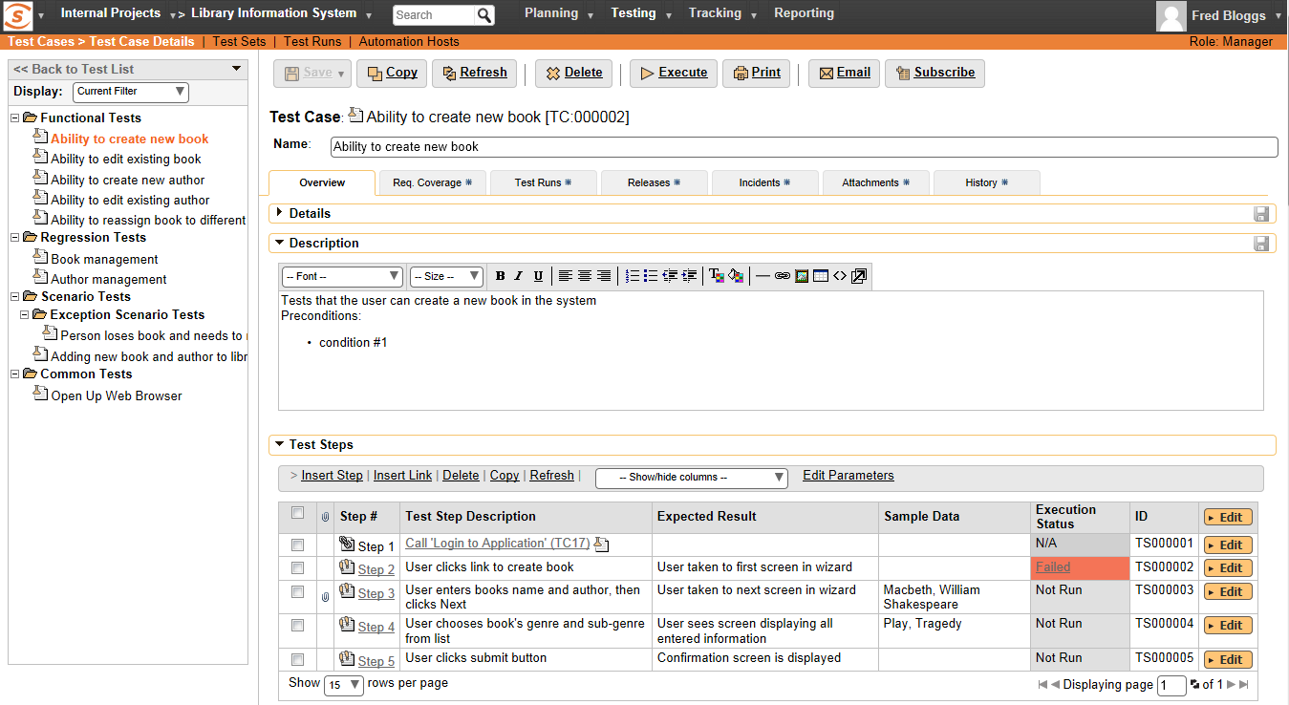
Manual Test Cases - Editing
Each test case consists of a set of test steps that represent the individual actions a user must take to complete the test.
You can include other template test cases as steps within your test case. This allows you to build a library of reusable test components.

Slide 29
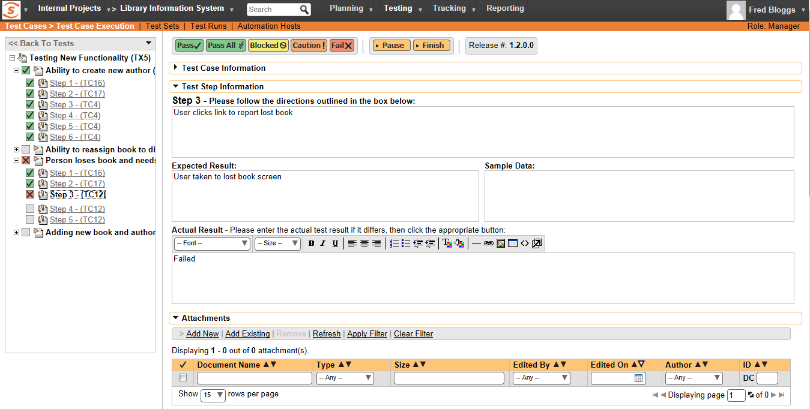
Manual Test Cases - Execution
You can execute groups of test cases - along with their test steps – so that the testers can follow the instructions and determine if the system being tested behaves as expected. Optionally a new incident can be raised in the system – linked to the test step failure

Slide 30
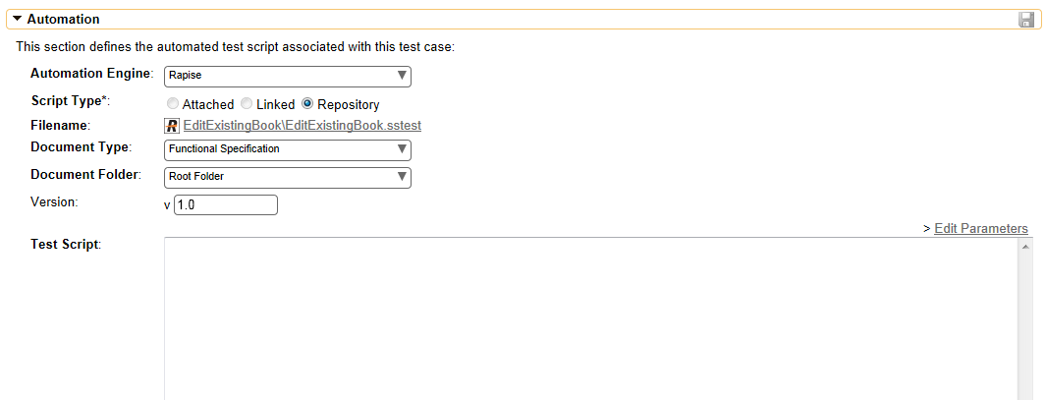
Automated Testing – Test Scripts
You can attached test automation scripts to test cases in SpiraTest.
SpiraTest supports a wide variety of test automation engines (both commercial and open-source) including Rapise, QTP, Squish, LoadRunner, TestComplete and Selenium.

Slide 31
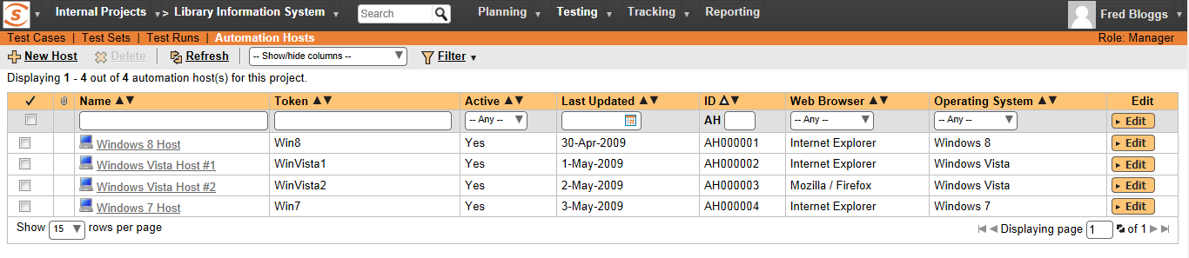
Automated Testing – Test Hosts
The automated test scripts managed in SpiraTest can be either executed on the local machine or scheduled for execution on a series of remote hosts.
Using Inflectra’s RemoteLaunch® technology, you can manage an entire global test lab from a central SpiraTest server, with test sets being executed using a variety of different automation technologies 24/7.

Slide 32
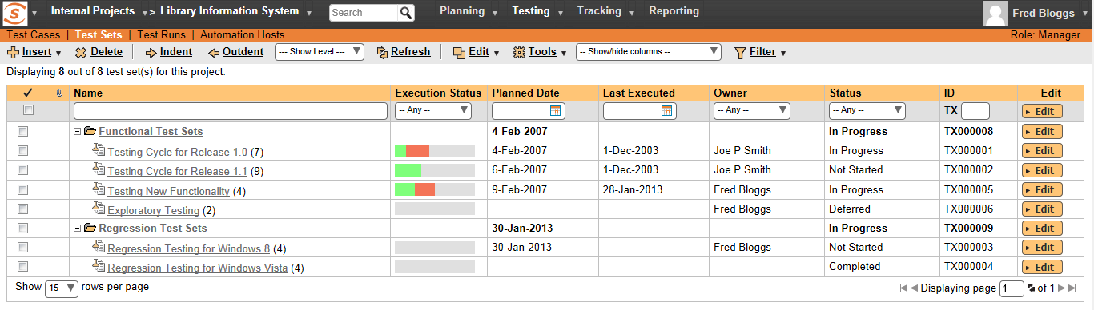
Test Planning - Test Sets
To make it easier to assign and track the execution of test cases, SpiraTest allows you to optionally group the test cases into test sets that can be assigned as a ‘package’ to individual testers or automation hosts.
Each test set can be associated with a particular release for testing, and you can quickly see the execution status of each test set in one consolidated view.

Slide 33
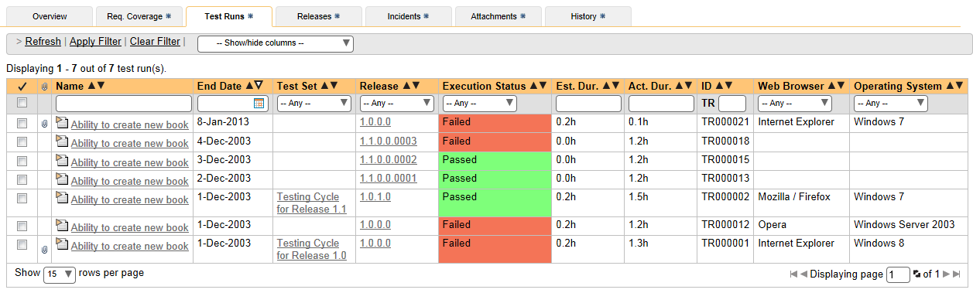
Test Run Tracking
Every time you execute a test case, SpiraTest records every pass / failure as well as the associated incidents generated as a ‘Test Run’. These archived Test Runs can be viewed to determine if changes to the system have introduced failures to previously working functionality.

Slide 34
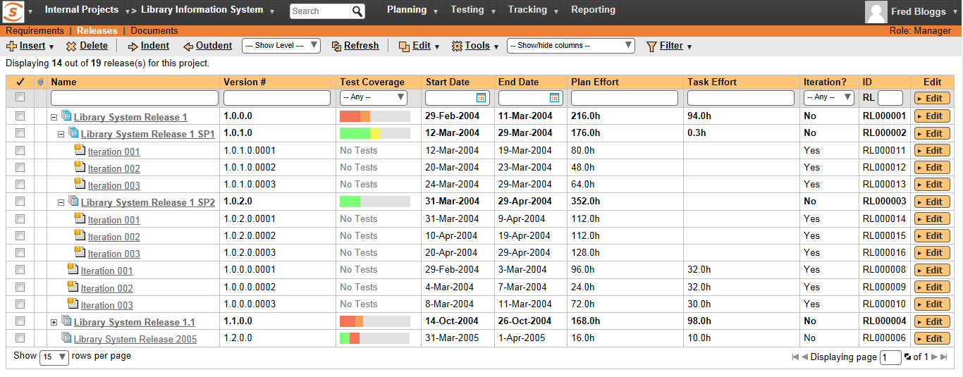
Release Management
SpiraTest provides the ability to manage the list of releases of the software being tested. During the execution cycle, the test runs and Incidents can then be associated with a particular release and reported on. Each release can contain iterations that allows you to track progress by sprint.

Slide 35
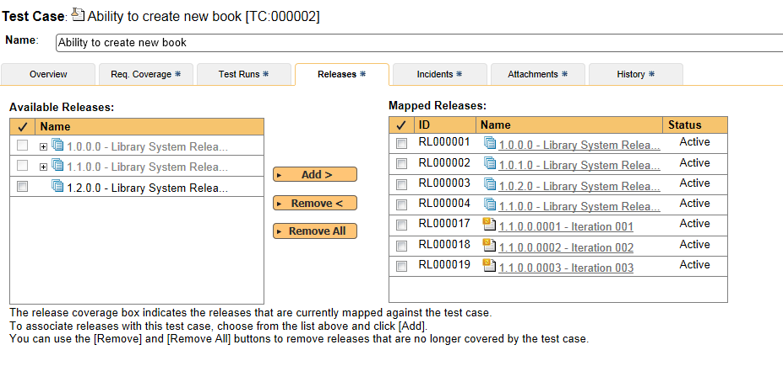
Share Test Cases Between Releases
The various test cases in the project can be associated with different releases, so that test runs and test case coverage can be reported on either in aggregate or separately for each release. This enables you to determine the quality of each release and also manage regression testing with ease.

Slide 36
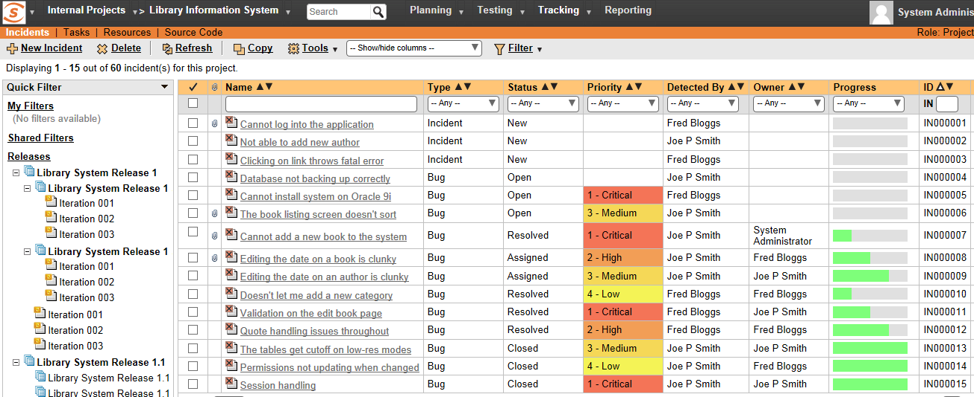
Incident / Defect Tracking
SpiraTest provides the ability to create, edit, assign, track, manage and close incidents (i.e. bugs, issues, risks, defects, enhancements) that are raised during the testing of the software system under development.

Slide 37
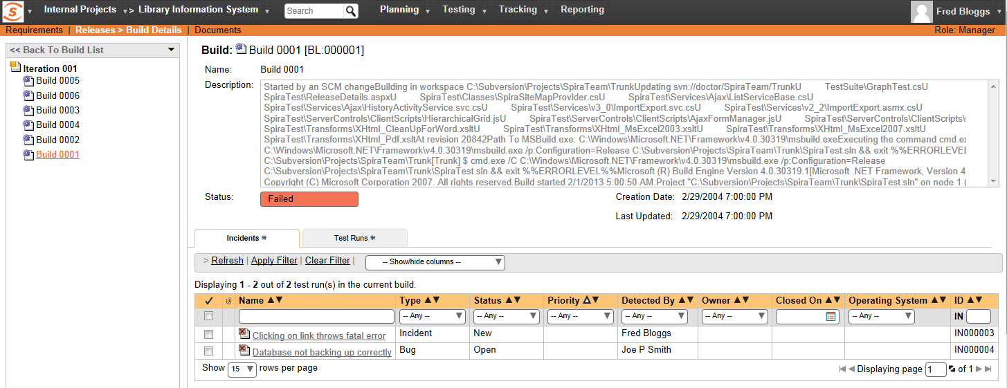
Build Management
SpiraTest provides the ability to integrate with continuous integration build servers such as Jenkins and Hudson so that the status of builds can be recorded in SpiraTest and linked to incidents and test runs. This provides traceability for each build, so that you can see what was tested in each build, and what was fixed.

Slide 38
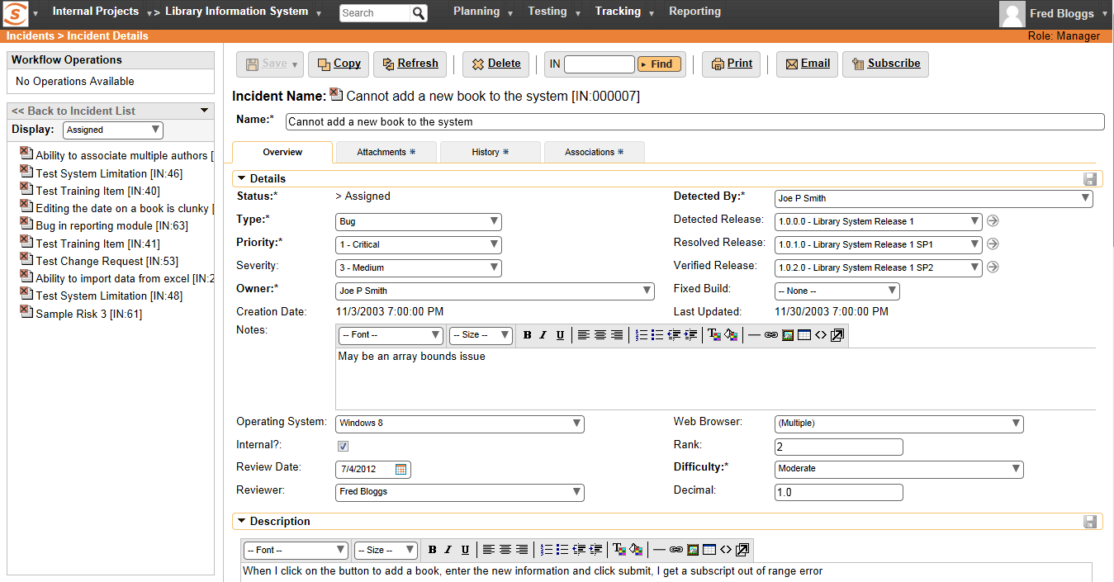
Incident Entry & Modification
Incidents can be categorized into bugs, enhancements, issues, training items, limitations, change requests, and risks, and each type has its own specific workflow and business rules.

Slide 39
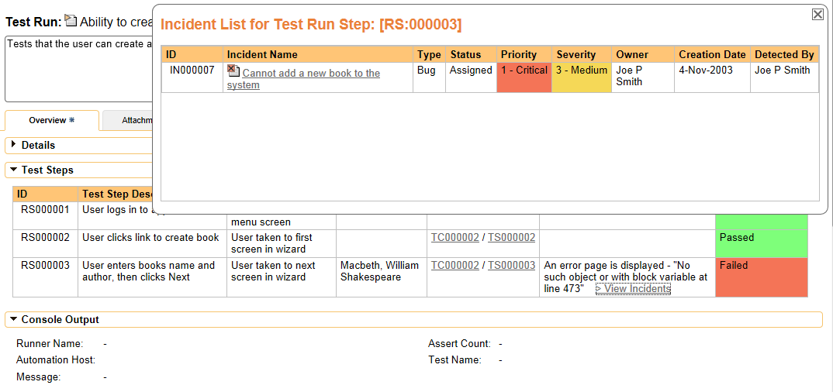
Incident Traceability
Unlike a standalone bug tracking tool, you can trace the defects back to the test case and the underlying requirement that generated them, giving the project manager unprecedented power in analyzing the “in-process” quality of a system during its lifecycle.

Slide 40
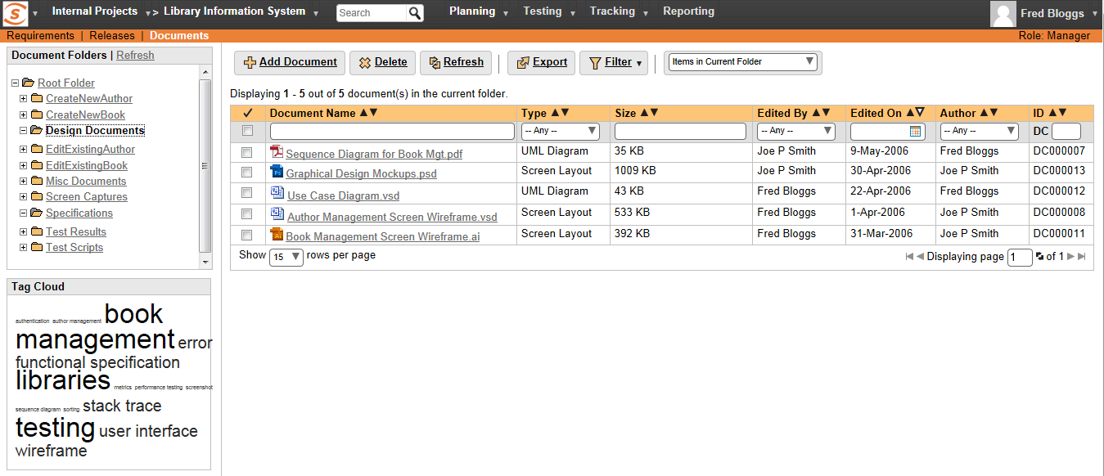
Document Management
All documents and web links uploaded to the system are available in the integrated document management system. This allows you to organize the documents into folders, categorize by document types and associate with meta-tags. Once uploaded, users can search, sort and filter the documents as well as find dynamically related items through the meta-tag hyperlinks.

Slide 41
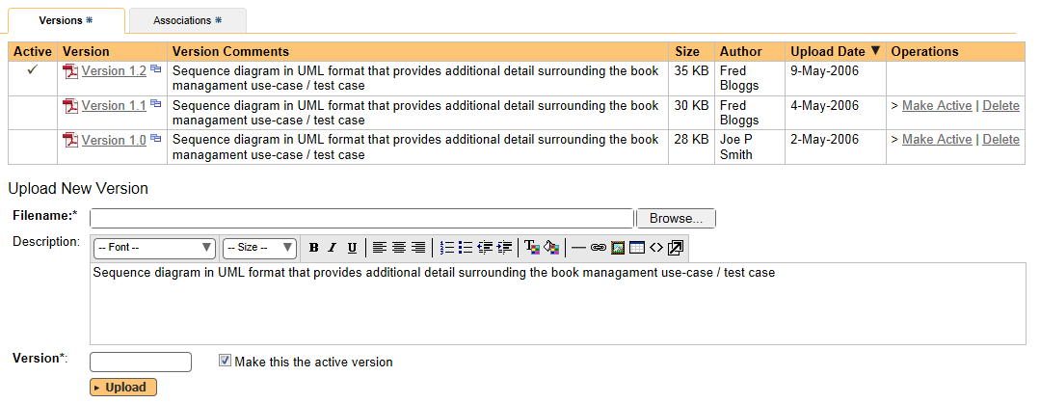
Document Version Tracking
Once uploaded to the central knowledge repository, revisions to the documents can be uploaded so that there is complete audit trail of all changes made to artifacts and associated documentation in the project.

Slide 42
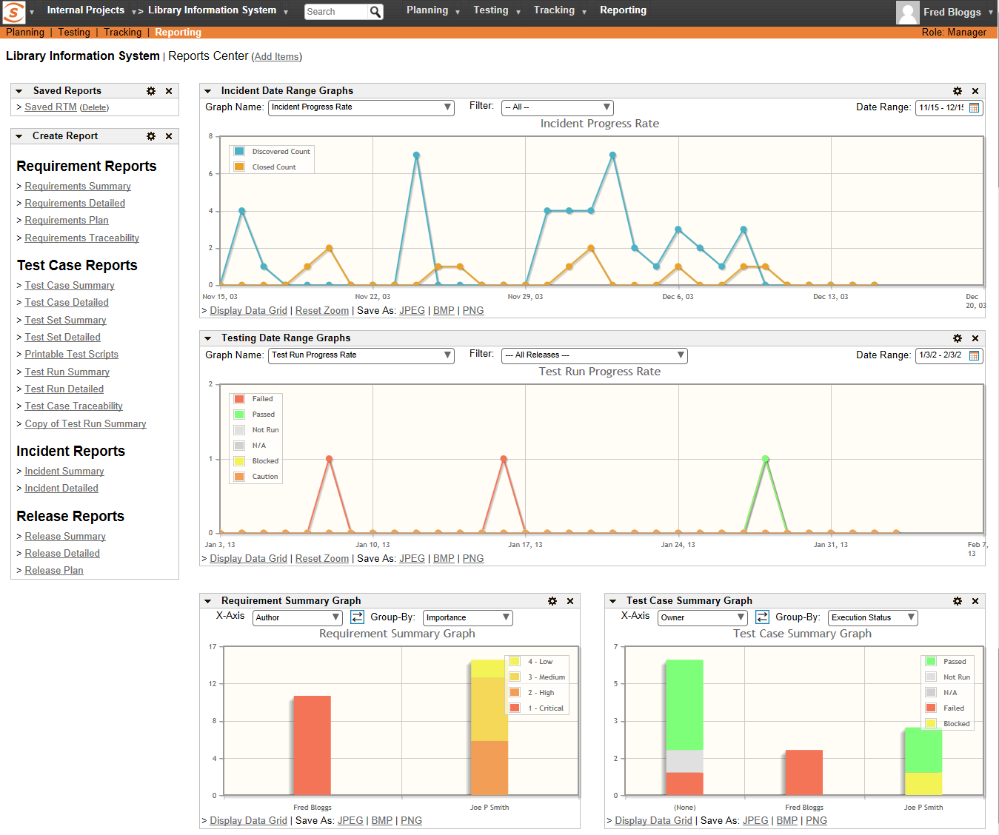
Customizable Reporting Dashboard
SpiraTest includes an extensive reports library that can display information such as Requirements Coverage, Test Case Execution, and Incident Status.
SpiraTest allows you to build a customized reporting dashboard featuring your frequently-used graphs, charts and reports.
The graphs available include: Requirements Coverage, Test Run Progress, Incident Discovery Rate, Cumulative Artifact Counts,
Supported formats include HTML, XML, Word, Excel.

Slide 43
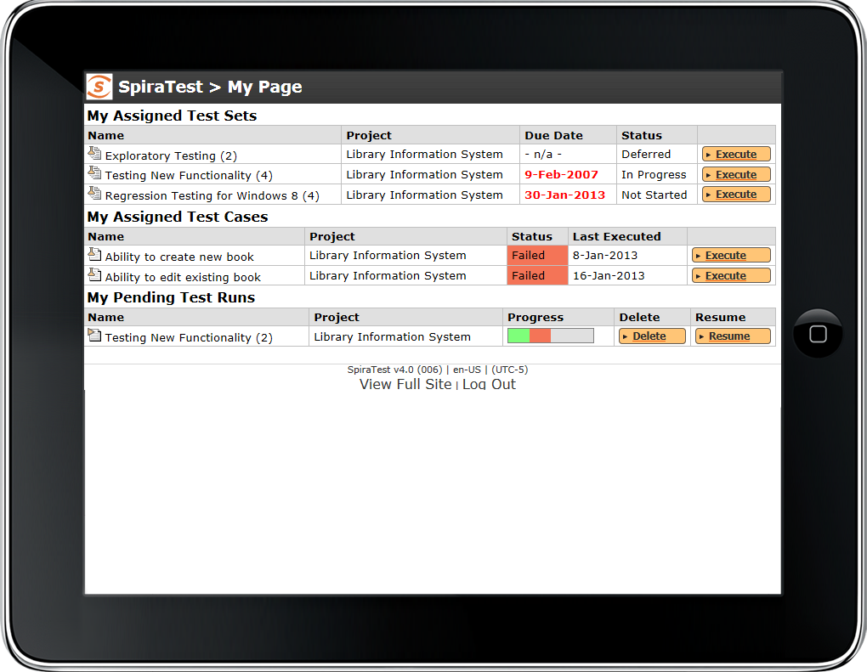



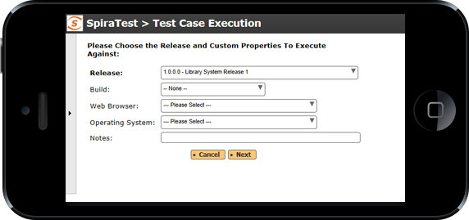
Support for Mobile Devices
SpiraTest provides a mobile web interface that allows users of smartphones, tablets and other mobile devices to view their dashboard of assigned test cases and execute their tests using the mobile device.
During test execution, you can attach screenshots to failed tests using the device’s built-in camera, providing additional context.

Slide 44
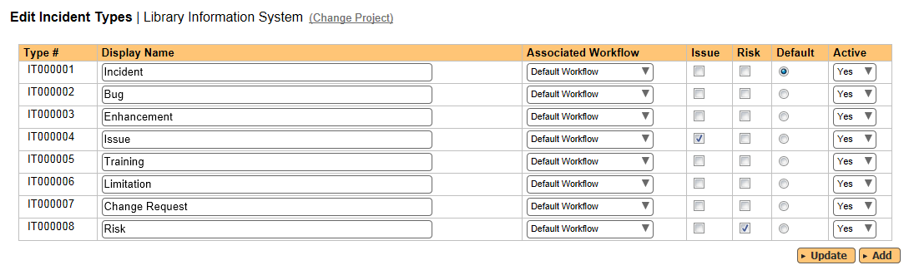
Customizable Incident Fields
You can customize each of the fields used in the Incident tracking module to suit your own business needs - including incident type, status, priority and severity. You can even associate your own color schemes with the different priorities and severities.

Slide 45
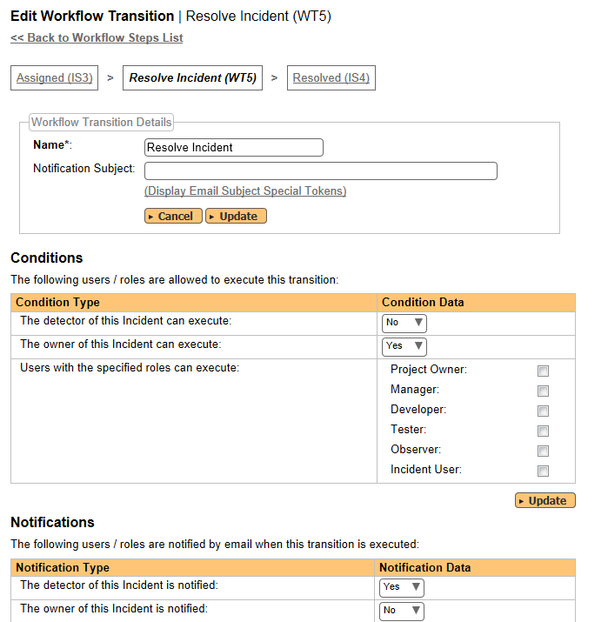
Customizable Workflows & Notifications
Different types of incident, and requirement can follow their own customized workflow. This allows you to tailor SpiraTest to the business processes used by your organization. Each workflow consists of a customizable set of steps and transitions.
In addition each transition can be used to send email notifications to the detector, owner or users in a certain project group.

Slide 46
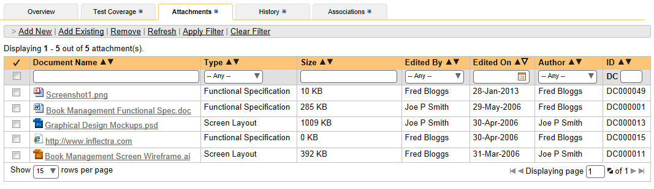
Attachments & Screenshot Capture
You can upload document attachments to Requirements, Test Cases, Test Runs, Releases and Incidents in the system. Each of these artifacts includes an attachment view that allows users to view the existing attachments, delete an existing attachment and upload new documents from their workstation.
In addition, there is a built-in screen capture utility for quickly adding screenshots to a test execution or incident report

Slide 47
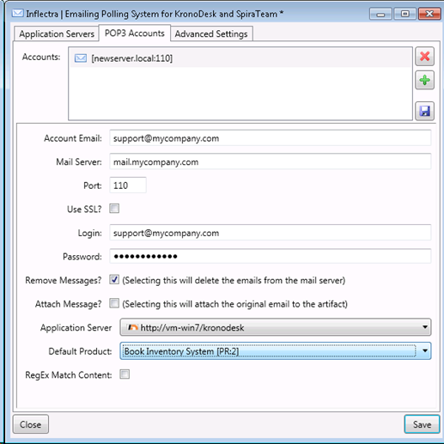
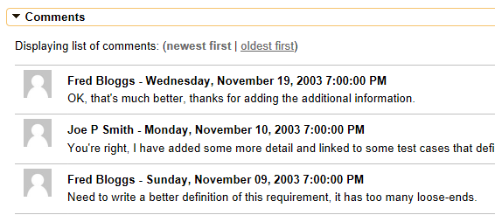
Email Integration
SpiraTest has a built-in email notification engine that lets you define custom email templates and notification events. This enables the system to send out notifications when specific events occur (e.g. user is assigned a test case, the priority of a requirement changes, etc.).
In addition, SpiraTest can connect to your email system and retrieve users’ comments and attach them to the appropriate artifact in the system. It can also create new incidents directly from emails, saving users’ time.

Slide 48
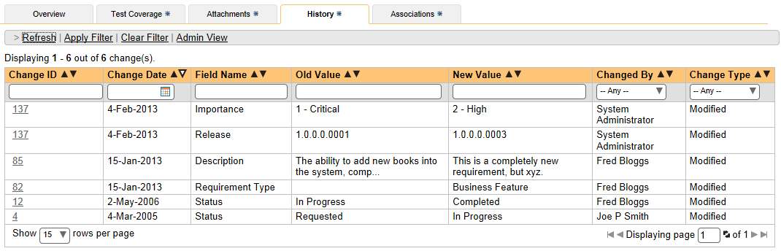
Change History Tracking
All of the changes made to a particular artifact in the system are tracked by SpiraTest, so that at any time you can view the history log of all the changes made to an artifact, including the date of the change, who made the change, and what information was changed.
SpiraTest features full version-control capabilities that allow you to rollback specific changes and revert the artifact back to a prior revision.

Slide 49
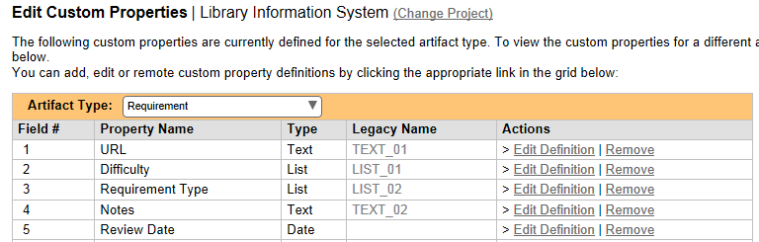
Custom Properties
In addition to the built-in fields that are associated with each type of artifact, you can also define custom properties for each type of artifact in the system.
The system supports a variety of different field types including: text, rich-text, dropdown lists, user selectors, and date-fields

Slide 50
Integration / Migration Options

Slide 51
Integration Overview
SpiraTest
Requirements
Test Cases
Releases
Defects
SpiraTest has a very flexible architecture and has been integrated with a variety of external tools and systems:
Various Tools
Requirements
Bugzilla
Defect-Tracking
Jira
Defect-Tracking
MS-Office
Legacy Data
Jenkins/Hudson
Build Server
Microsoft TFS
Defect-Tracking
Automated Testing Systems
xUnit
Unit
Testing
Rapise
Functional
Testing
Various Tools
Functional
Testing
Various Tools
Performance
& Load Testing

Slide 52





Automated Functional & Load Testing Tools
Functional testing tools:
  Inflectra Rapise® functional testing system
  HP QuickTest Pro™ functional testing system
  Selenium IDE and WebDriver functional testing framework
  TestComplete™ and Soap-UI from SmartBear
  Squish® multi-platform test automation system
  SmarteScript™ functional testing system
  Ranorex functional testing system
  Rational Functional Tester (RFT)
  FitNesse open-source testing framework
Load/Performance testing tools:
  HP LoadRunner load-testing system
  Neotys NeoLoad load testing system
  JMeter open-source Load Testing System

Slide 53






Automated Unit Testing Tools
SpiraTest can integrate with a variety of automated unit testing tools and frameworks:
  NUnit and MS-Test frameworks for .NET
  JUnit & TestNG frameworks for Java
  PyUnit framework for Python
  TAP framework for Perl
  PHPUnit framework for PHP
  Test::Unit framework for Ruby

Slide 54

Integration with Build Servers
SpiraTest® is able to connect to your continuous integration (CI) build server to link tests and defects with continuous builds:
Currently Available:
  Hudson
  Jenkins
Planned:
  CruiseControl
  TeamCity
  Atlassian Bamboo

Slide 55






Integration with Bug-Tracking Systems
SpiraTest® is able to leverage your existing investments in bug / issue tracking systems:
Current
  Synchronize incidents with Atlassian JIRA
  Synchronize incidents with Bugzilla
  Synchronize incidents with FogBugz
  Synchronize incidents with Mantis
  Synchronize incidents with Microsoft Team Foundation Server
  Synchronize incidents with AxoSoft OnTime
  Synchronize incidents with IBM Rational ClearQuest and RTC

Slide 56




Integration with Requirements Mgt Systems
SpiraTest® is able to leverage your existing investments in requirements management and UML modeling systems:
  Synchronize requirements with IBM Rational RequisitePro
  Synchronize requirements with Sparx Enterprise Architect
  Synchronize requirements with Jama Contour
  Synchronize requirements with IBM DOORS
  Synchronize user stories with Version One

Slide 57





Data Migration Options
SpiraTest® makes it easy to import data from a variety of existing legacy data sources:
  Import requirements, test cases, incidents and test runs from any software package capable of exported in MS-Excel, MS-Word or MS-Project formats
  Import requirements, test cases, incidents and test runs from HP ALM, HP QualityCenter and Mercury TestDirector.

Slide 58
Questions?
Please contact info@linksoft.com.tw if you have additional questions.

Slide 59








Q&A

