Slide 1


Tempo Timesheets
JIRA plugin
Sapphire • Linksoft Inc • @ Live DEMO 2015
V0.1

Slide 2
Who use the TEMPO?
How it works?
Tempo Advantage
How it works

Slide 3


Who use the TEMPO

Slide 4

Who use TEMPO Timesheet

Slide 5
How it works

Slide 6
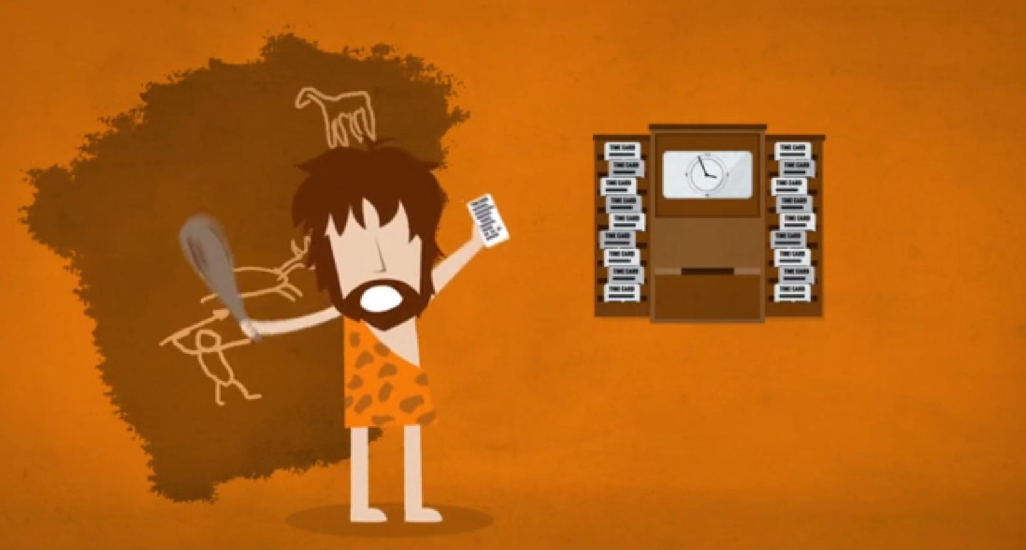

Time tracking and planning
古時候我們打卡
現在我們電子化登錄時間
But if our work comes down in torrents？

Slide 7

Team Members
一鍵啟用、於背景自動計算工作時間
快速、即時的追蹤表格
輕鬆轉成各式統計分析圖表
※能更專注在工作上、不必費心紀錄時間
Click!

Slide 8
Project Managers
有效且快速、精準的分配 member / team / project 資源
準確的、即時的監督並衡量績效
甚至安排vacation time (sick time)

Slide 9
Executives
Create BI Reports
Integrate with your financial system
Streamline your business
Detailed snapshots of time utilization
Real-time timesheet and report views

Slide 10
Tempo Advantage

Slide 11
What can tempo do
Easy time tracking
Flexible reporting
Centralized team management
Accurately allocate resources
Internal time management
Planned time and timesheet approvals
Real-time business data

Slide 12
Overviews

Slide 13
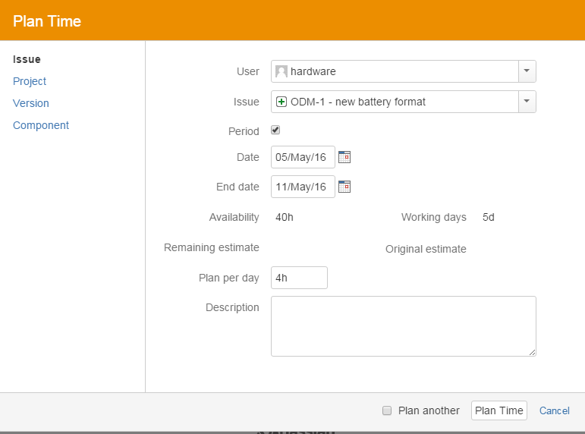
Plan times
以不同層級/角度規劃時間
彈性計算此人總共剩餘時間
以工作日來計算
規劃時間在此Issue上

Slide 14
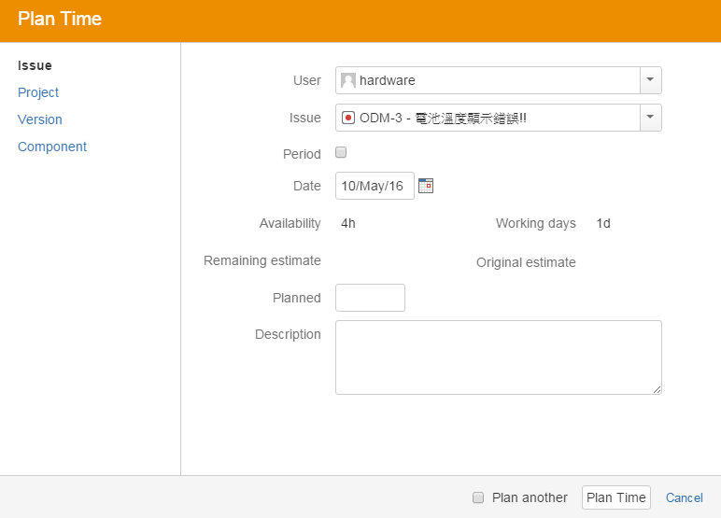
Real-time response
派其他任務給此成員時，可知該日他剩餘工作時間

Slide 15
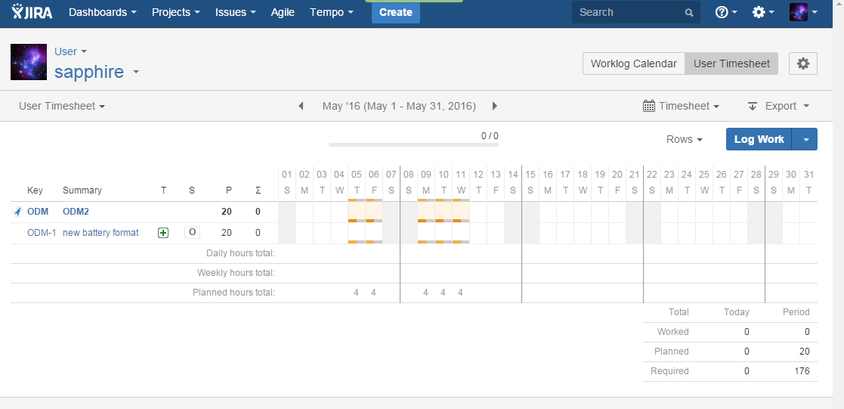
Traking bar by member

Slide 16
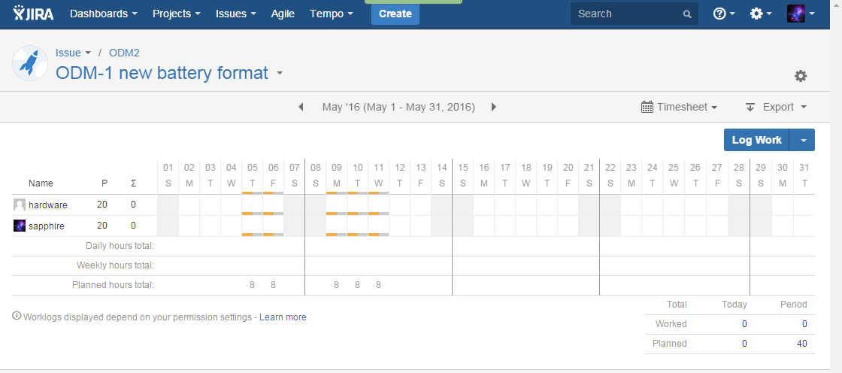
Traking bar by Issue

Slide 17
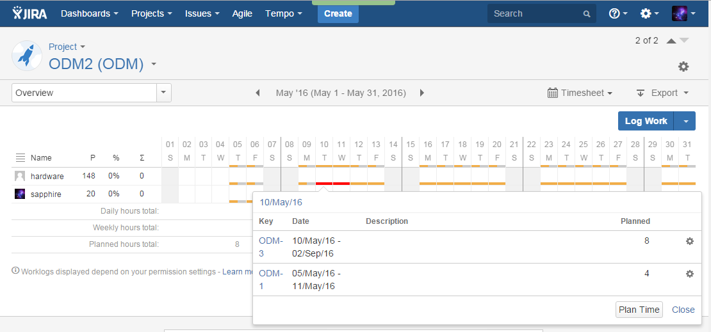
Traking bar by Project
And you can check detail on it, too.

Slide 18
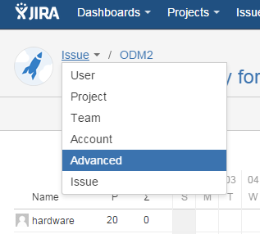
Traking bar by …
There are more things you can do:

Slide 19
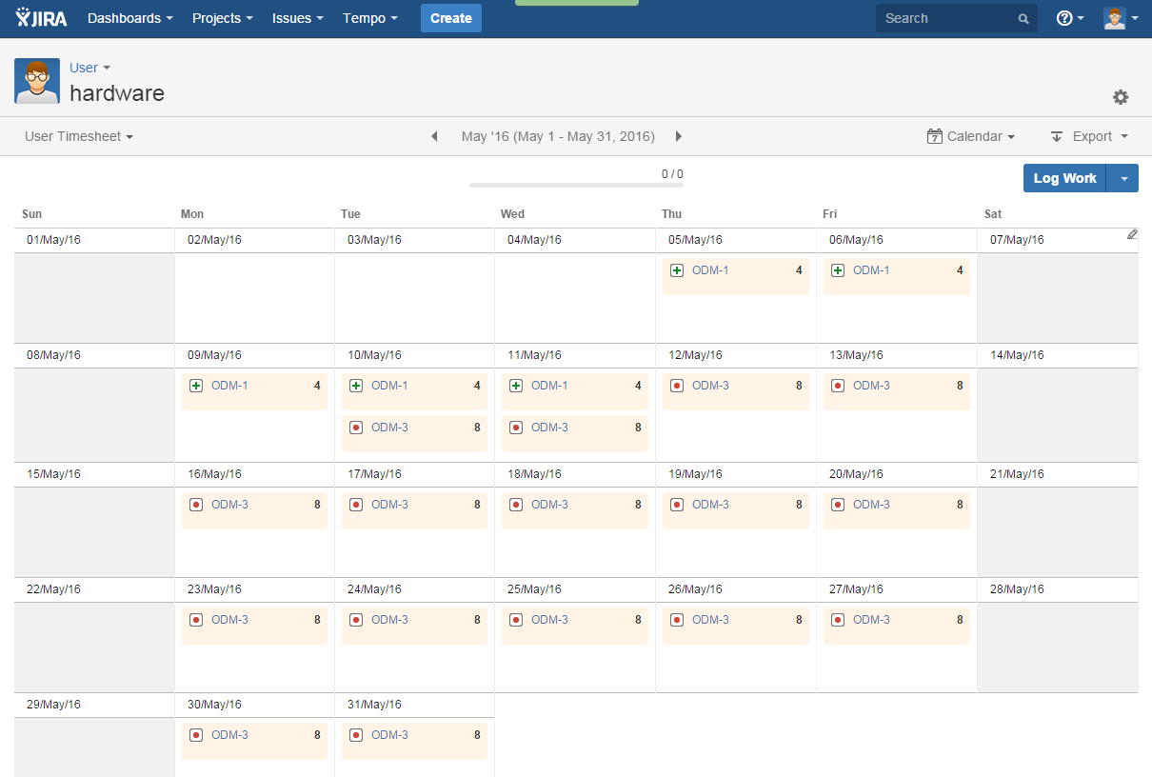
Working time Calendar

Slide 20
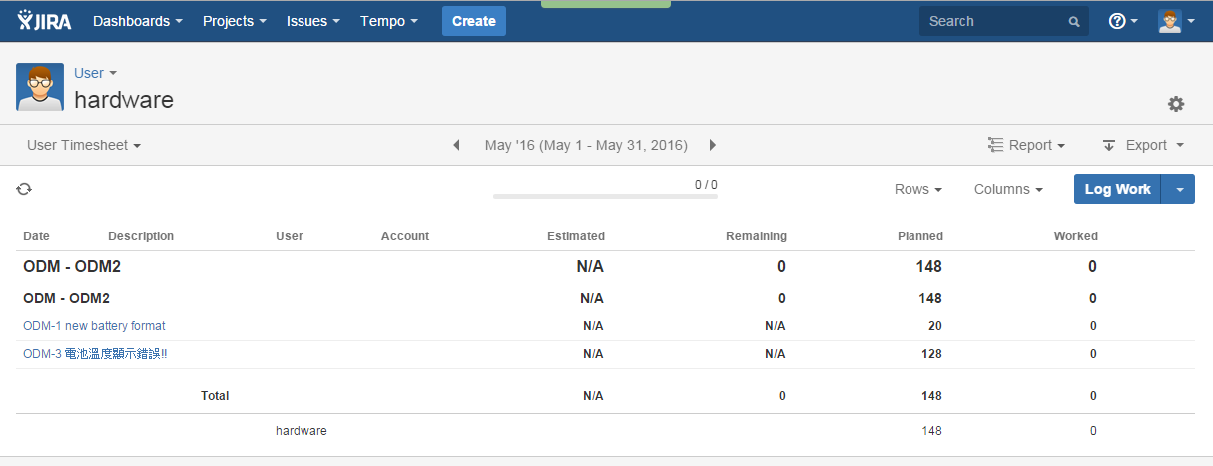
Time report

Slide 21
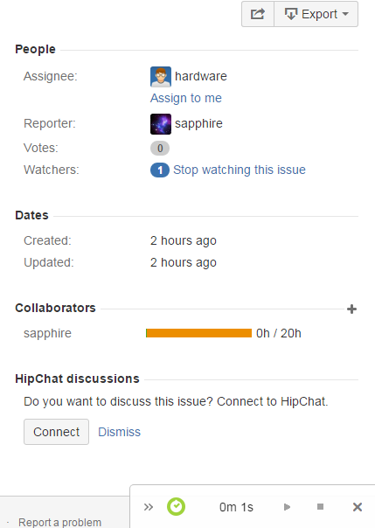
Click and run
一鍵開始計時，可暫停可停止可結束
Click and run the time!

Slide 22
Okay, now...

Slide 23
You just need:
+

Slide 24

What’s more?
Contact your consultant:

Slide 25






Q&A

