Slide 1
Testflo for JIRA
Dream it Plan it Do it
Klus • Linktech Inc • @ CyberTan
V2.1

Slide 2
Testflo Concept

Slide 3
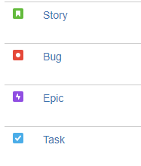
Issue Type
Standard Issue Type | Sub-Task
Epic Story Bug Task | Sub-Task
Testflo Function Standard Issue Type | Testflo Function Sub-Task
Test Cast Template(TCT) Test Plan (TP) | Test Case (TC)

Slide 4
Test Case Template(TCT)
Consider it as reusable TC definitions. One TCT can be used as template for many TCs under Test Plans.

Slide 5
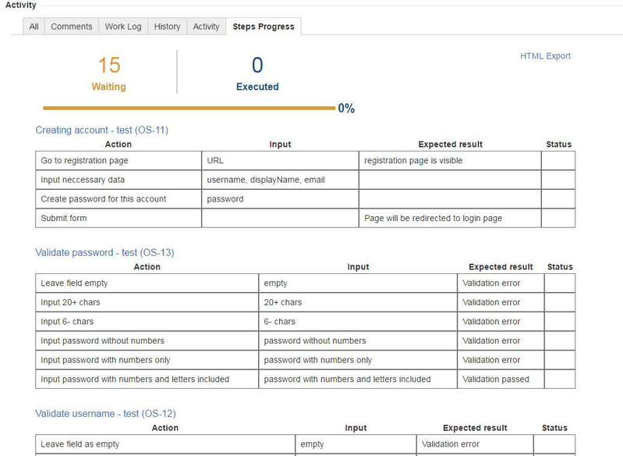
Test Plan(TP)
Step Progress

Slide 6
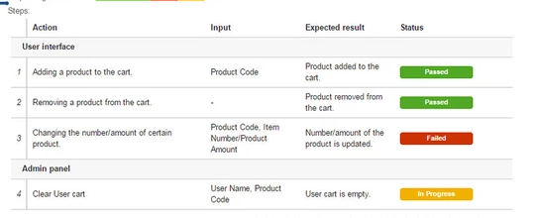
Test Case(TC)
Test Step

Slide 7
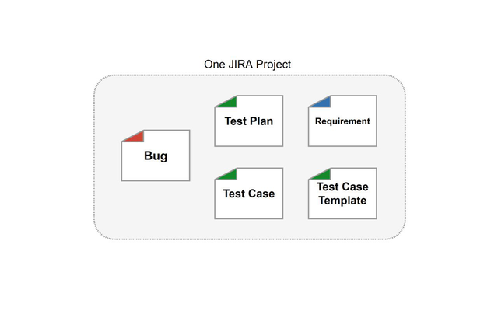
Testflo Project Organization
Simple Solution

Slide 8
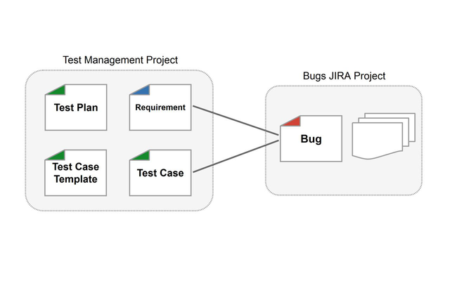
Testflo Project Organization
Test Management Project

Slide 9
Testflo Project Organization
Test Management Project

Slide 10
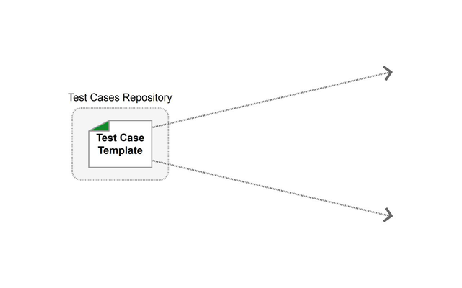
Testflo Project Organization
Test Cases Repository

Slide 11
Q&A

