Slide 1
Digital Automation Intelligence
Automate end-to-end testing | Test the untestable | Deliver amazing digital experiences
MM/DD/2017

Slide 2
Amazon reports that a 100MS increase in app response time translates into a 1 % drop in revenue.
According to a study by SAP, 78% of enterprise apps are abandoned after their first use.

Slide 3
The digital experience and DevOps changed everything…
Poor app experiences
Directly impact revenue
Customers demand
Quality and performance
The best enterprises
Continuously deliver customer value
The user experience is everything
And challenges our existing testing approaches…

Slide 4
The impact of the digital experience and the testing gaps…
80% | 96% | 52%
80% of downloaded apps used only once
96% not used after the first month
52% of application users dislike their experience
#2 | 8% | >50%
Testing is the #2 barrier to continuous delivery
Only 8% of teams have >50% automation
44% | 4%
44% of teams don’t have enough time for core testing
Less than 4% of testing effort spent on user-experience

Slide 5
And complex digital systems mean complex testing environments…
Mobile – any device
IoT – test across device, edge, cloud, GUI
Packaged Apps
Custom devices - POS, ATM, handhelds
Robots & Drones
Test multiple networks & geos - wired, GSM, wifi
Test on premise, cloud & hybrid
Web – any browser

Slide 6
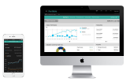
The digital experience creates testing challenges in every enterprise…
New technologies are taking hold: Kiosk, to POS to mobile
Much of this new technology is in the hands of the user
Huge manual test burden to ensure a quality digital experience
DevOps approaches needed to release features at the speed customers demand
Responsive web application platforms demand user centric testing
Robust test automation is required to match velocity of a DevOps delivery engine
Mandated technology rollouts to track and manage health records over time
Data intensive, doctor and patient facing apps must be high-performing
Large volume of test data requires automated regression and functional testing

Slide 7
But are we prepared to address the challenges?
“Only 18% of teams have a test strategy that they believe will meet their quality aspirations.”
PAC Digital Testing 2016
64% do not have a testing approach that they think fits well with Agile or DevOps.
56% cannot apply test automation to their testing objectives.
51% are not sure what to do to test the user experience.
CapGemini World Quality Report 2016

Slide 8
A new approach to testing the digital experience is needed…
Test the digital experience through the eyes of the user
Implement true test automation
Correlate test results with customer satisfaction
Quality | Functionality | Responsiveness | Performance | Usability

Slide 9
eggPlant Delivers End-to-End Digital Automation Intelligence
eggPlant is the #1 solution to help you achieve test automation and improve App quality.
Easiest to adopt and deploy.
Most productive in terms of script creation/maintenance.
Reliable universal technology coverage.
Natural fit with Agile and Shift-left:
Story and user oriented.
Usable by business analysts, developers, and testers.
Scripts can be written before code.
Management
Testers
Test
environment

Slide 10
Seamless integrations improve efficiency & visibility across dev environments
ALM and
Test Management
CI / DevOps
Domain Specific
and Other Tools

Slide 11
eggPlant is built for Agile and DevOps…
Ensure a high quality end-to-end digital experience by testing through the eyes of the user and integrated performance and network emulation testin3g.
Support rapid iterations and changing user needs with automated end-to-end UX and regression testing
Validate user stories not code, with functional testing coverage from a true user perspective.
Collaborate across the delivery team with natural language test scripts that everyone can understand

Slide 12
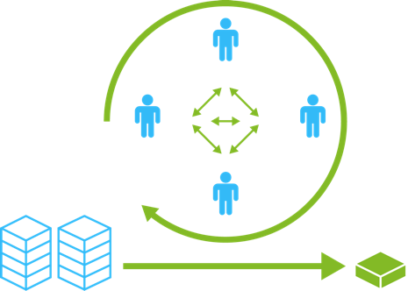
User centric test automation is ideally suited to Agile teams…
Support rapid iterations and changing user needs with automated end-to-end UX and regression testing
Validate user stories not code, with functional testing coverage from a true user perspective.
Collaborate across the delivery team with natural language test scripts that everyone can understand
Sprint or Iteration
Build Engineer
Product Owner
Testers
Developers
Backlog
Product Increment

Slide 13
Integrated test automation designed for Devops and CI teams…
DevOps Lifecycle
Customers
Business
Owners
Development
& Test
Operations/
Production
Ensure a high quality digital experience with integrated performance and network emulation testing
Test user stories and deployment readiness from a true users perspective
Collaborate across the team with natural language test scripts that everyone can understand
Monitor
& Optimize
Develop
& Test
Release
& Deploy
Continuous
Test Automation

Slide 14
eggPlant Functional puts the user at the center of testing
Intelligent image recognition and OCR with natural language scripting
Technology agnostic, end-to-end and truly cross platform
Full device control
Script once, deploy to multiple devices and platforms

Slide 15
eggPlant Performance delivers future-proofed performance testing
Future proofed, comprehensive technology support for web, Citrix, client-side .NET and Java, and TCP/UDP.
Easy and productive test script creation tools designed designed to get test teams up and running quickly
Cloud-based, distributed, load injection to easily scale to real-world user load simulations
Powerful analysis and reporting supports quick issue resolution. Dynamic test control and monitoring deliver full control your automated tests while running

Slide 16
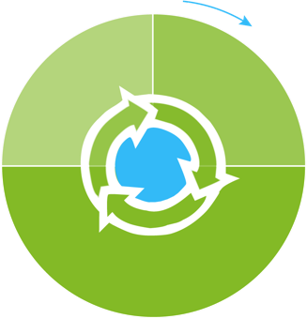
FastStart Services, best practices and unlimited support for successful adoption
KICK-OFF
Account Manager
Continue
& grow
Deploy & transition
Test environment validation, installation and configuration
Training and best practices sessions
Co-developed automation scripts
Unlimited email and web based support
Technical Account Manager
SUCCESS
eggPlant
Community
Engage
Documentation
Email support

Slide 17
Customers and Sectors
Telco
Enterprise
Finance
Retail
Media
Engineering

Slide 18
Digital banking transformation at Nationwide
One of the largest global mortgage and financial service providers and an industry leader in digital technology
Delivering several new app services including smart watch and digital wallet
Testing over 250 device and browser combinations
Need remote testing while maintaining the highest security standards
TestPlant delivered...
Secure, remote testing capabilities with eggPlant Functional, eggCloud and eggIntegration
Scaled testing to 50 remote testers across a wide range of platforms
Ease of integration with existing development and Citrix infrastructures
We worked closely with TestPlant on the development and implementation of the new architecture needed to support our remote testing goals, and the support team was incredibly helpful throughout the process,”

Slide 19
Service Monitoring at NTT Docomo
Japan’s largest telco provider servicing over 68 million customers
Releasing new and innovative internet services while fulfilling a mission to maintain a highly stable communications infrastructure
Needed to assure high-quality user services across different networks and content that can vary based on time-of-day and cloud environments
Previous solutions were not maintainable and lacked the automation to continuously monitor the quality of user facing services
TestPlant delivered...
eggPlant Functional adopted as core QA Automation and functional testing solution
Used high-precision image recognition technology records automatic services operations across multiple devices including iOS and Android
24/7 services monitoring system vastly improved user experience across platforms and networks
“This new automated service monitoring system [eggPlant] enables us to identify the degree of a failure from the viewpoint of users.” - NTT Service Operations Manager.

Slide 20
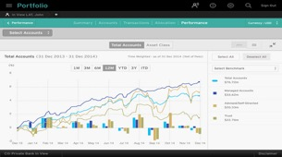
Mobile and web app testing in DevOps at Citi Bank
The leading global financial services company with over 200 million customer accounts
Needed a testing suite for all web and mobile apps
Rolling out responsive web-design platform across all technologies: Web, Mobile, Tablet
Existing UFT and mobile testing solutions were not platform and technology agnostic
TestPlant delivered...
True, technology agnostic functional testing capabilities with eggPlant Functional
Integration with CA Agile Requirements Designer to generate test scripts from requirements in a continuous delivery environment
A 4X increase in test case creation velocity
“Using eggPlant with CA Agile Requirements Designer combines all the benefits of automated test execution, optimized test creation and accelerated test maintenance.”

Slide 21
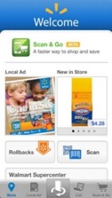
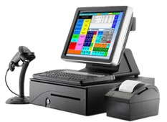
Responsive on-line retail at Walmart
The world’s largest retailer with 11,500 stores in 28 countries
Historically conducted manual tests on a complex POS tech stack
The manual test team not able to keep up with Agile dev team velocity and there was increasing reliance on consultants
Current testing solutions could not support automation throughout the POS technology infrastructure
TestPlant delivered...
Functional test automation with a GUI based approach on the POS system
Supported testing in a product state, with integration and control of KVM switches to run POS terminals
Automated over 2,500 test scripts and reduced manual testing days from 125 to 10 per release cycle

Slide 22
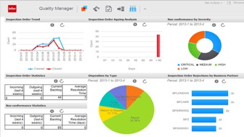
Enterprise Resource Planning (ERP) at Infor
Top ERP Solutions provider with 4,500 customers in 68 countries
Releasing cutting-edge products that require compatibility, interoperability and integrations with new systems, apps and mobile
Existing testing solutions simply did not support the new systems and cross platform testing requirements
Ease of use for any testing solution was of paramount importance in an already technically complex app environment
TestPlant delivered...
eggPlant Functional adopted as core QA Automation and functional testing solution
Functional testing on all major Web browsers, Java and .NET rich client UIs, and iPad and all major mobile devices
Tests running 24X7 across Lawson’s test automation framework
“The scripting that TestPlant has used is particularly nice... This makes it so much easier for us to hand-off scripts for others to follow without further guidance.”

Slide 23
Visionary: Magic Quadrant for Software Test Automation (2015)
Top Score: Critical Capabilities for Software Test Automation (2016)
Visionary: Magic Quadrant for Software Test Automation (2017)
Top Score: Mobile Apps Critical Capabilities for Software Test Automation (2017)
Strong Performer: The Forrester Wave™ Modern Application Functional Test Automation Tools
Strong Performer: in Modern Application Functional Test Automation Tools (2016)
Strong Performer: The Forrester Wave™: Mobile Front-End Test Automation Tools (2016)

Slide 24
Next Steps
Set up a trial and schedule time with an eggPlant Technical Consultant
Let’s define a successful trial experience means to you and your team
Understand how eggPlant FastStart™ supports your first 30/60/90 days

